Slide 1
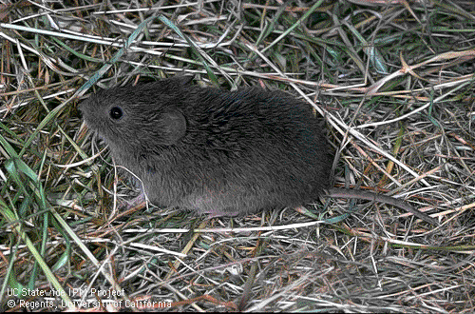
MEADOW VOLES (Meadow Mice)

Slide 2
Thanks to the following for use of pictures:
Dr. Oliver Neher, TASCO
Danielle Gunn, UI Extension Educator
Dr. Glenn Shewmaker, UI Forage Specialist, retired
Sherman Takatori, ISDA

Slide 3
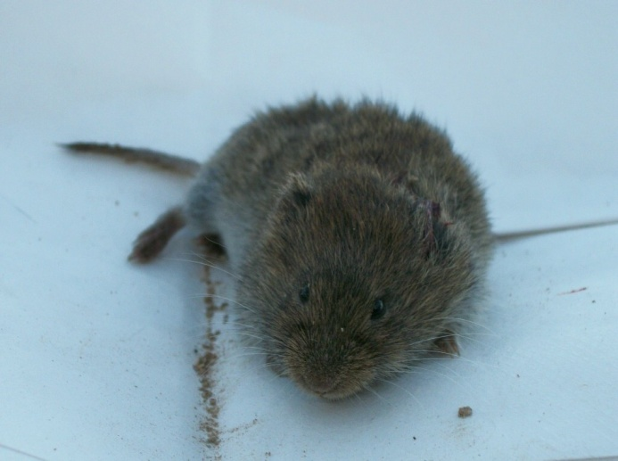
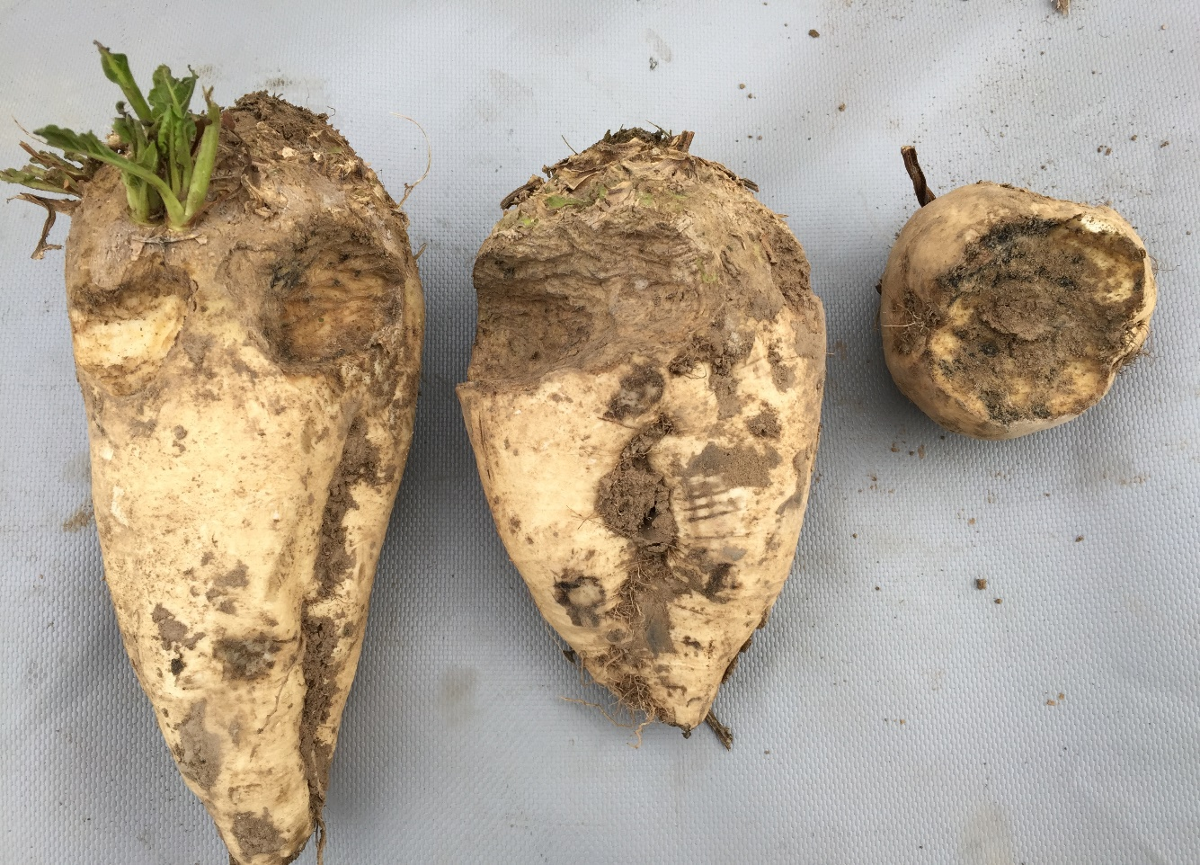
Vole Overview
High population peaks
Significant crop damage to forages, small grains, sugar beets, potatoes, others
30%+ yield losses
Non-game mammals, can be legally managed on private property and public lands

Slide 4
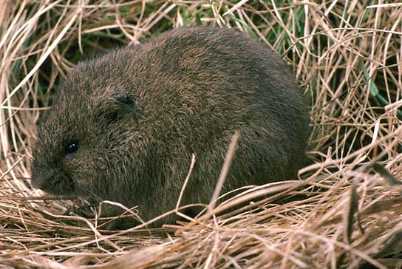
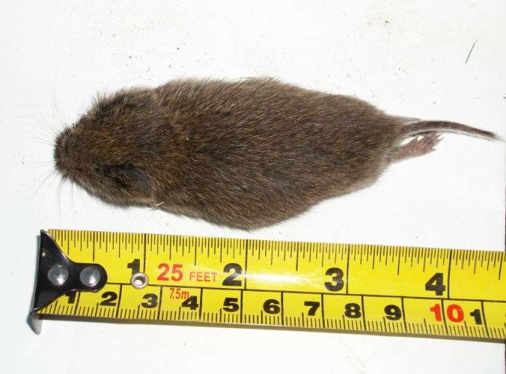
Vole Biology
Several species—Meadow Vole most common
Sometimes call Meadow Mouse
Small rodents
Heavy body, short legs and tail, small and rounded ears
4 ½” – 5 ½” long
Blackish to grayish brown fur with black-tipped hairs
Bi-colored tail

Slide 5
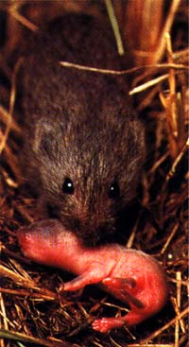
Vole Reproduction
Peak breeding in spring and fall
Reproductive maturity at 35-40 days
21 day gestation period
Nests are underground made up of grass, stems, leaves
Reproduce year-long
Average 1-5 litters/year
3-6 young/litter
Live up to 2 years, most less than 1 year

Slide 6
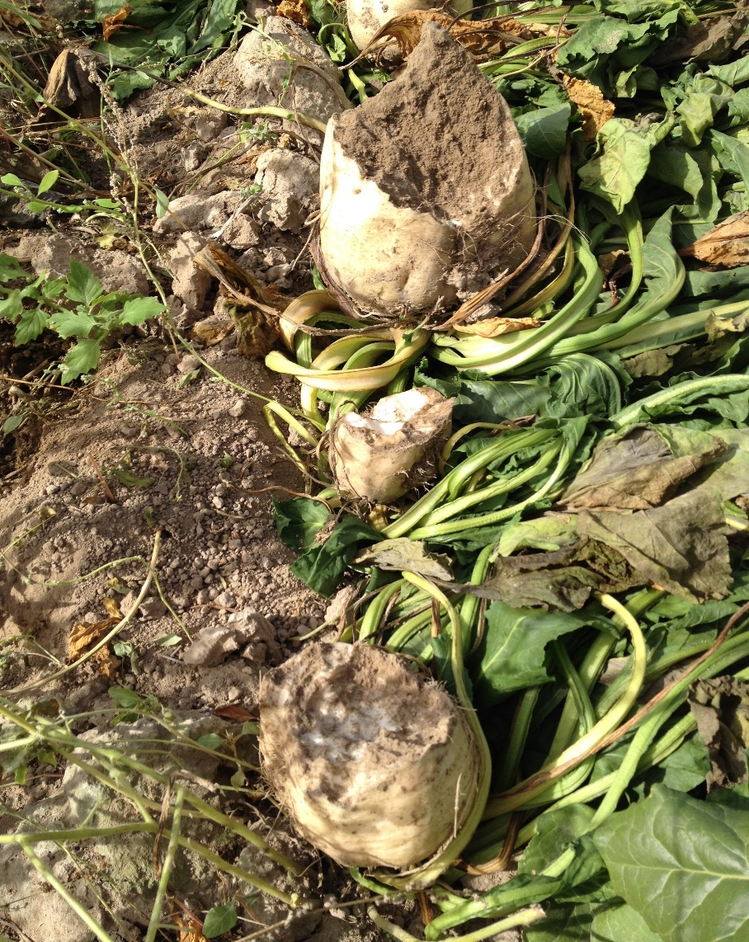
More……….
Populations increase rapidly and are cyclic
Populations can fluctuate dramatically from year to year
Minor peak populations every 4-6 years
Epidemic populations every 10-12 years
Population explosions generally only last about a year

Slide 7
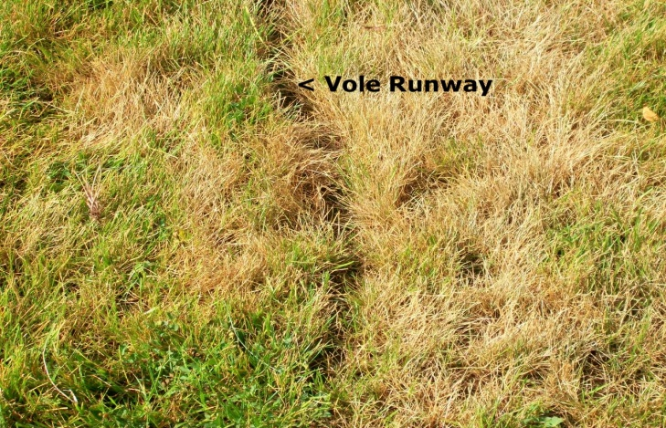
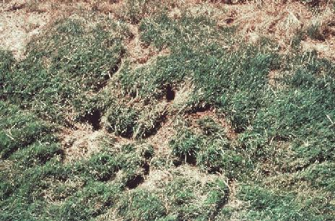
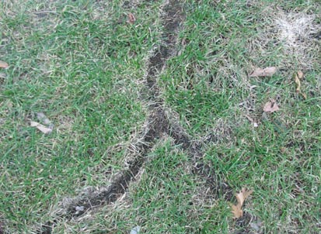
Vole Behavior
Active year-round (they do not hibernate)
Prefer dense ground cover
Do NOT like crossing bare ground
Dig short and shallow tunnels on the surface and underground
“Runways” have the vegetation clipped to the ground
Tunnel under snow cover

Slide 8
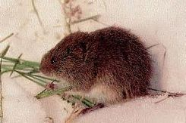
Habitat: vegetation > 6 inches, snow cover, brush piles, leaves, low-hanging tree limbs provide protection
Pastures, rangeland, orchards, crops, hayfields, home lawns and gardens all provide good habitat and food sources

Slide 9
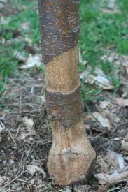
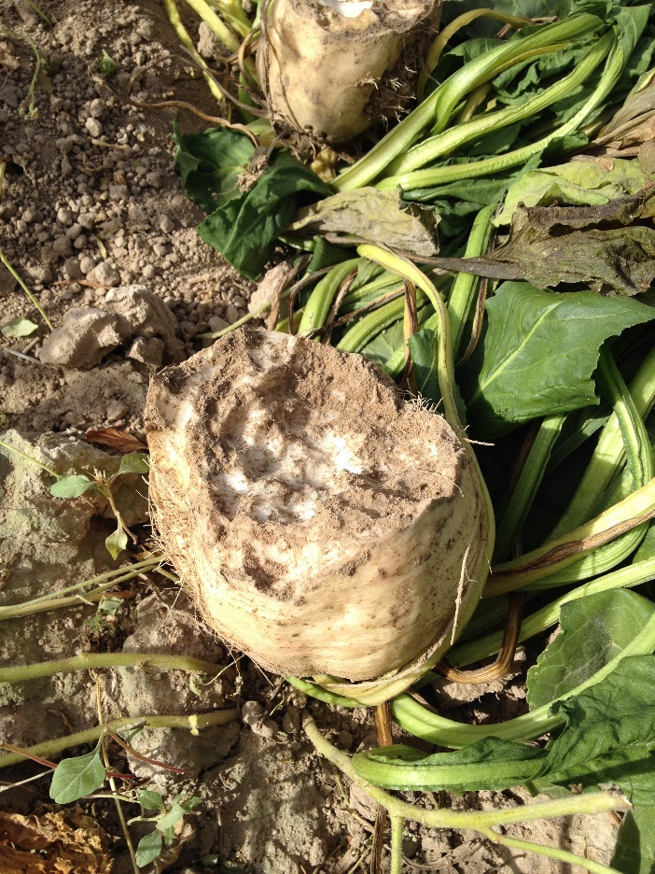
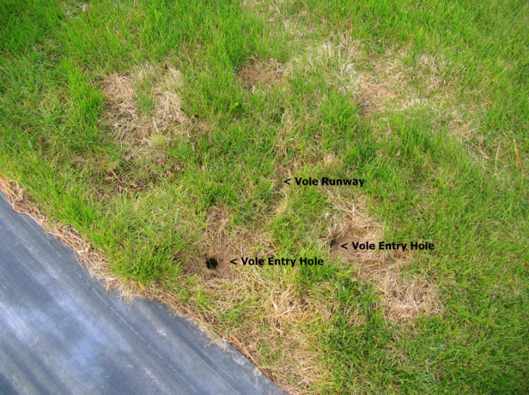
Vole Feeding Characteristics
Most vole damage is from feeding on crops or tree bark
Diet consists of green vegetation, roots, seeds, tubers, bulbs, tree and shrub bark, insects, vegetables
Can eat nearly their body weight daily (3-4 oz)
Damage trees by girdling and removing bark
Forage under snow for food

Slide 10
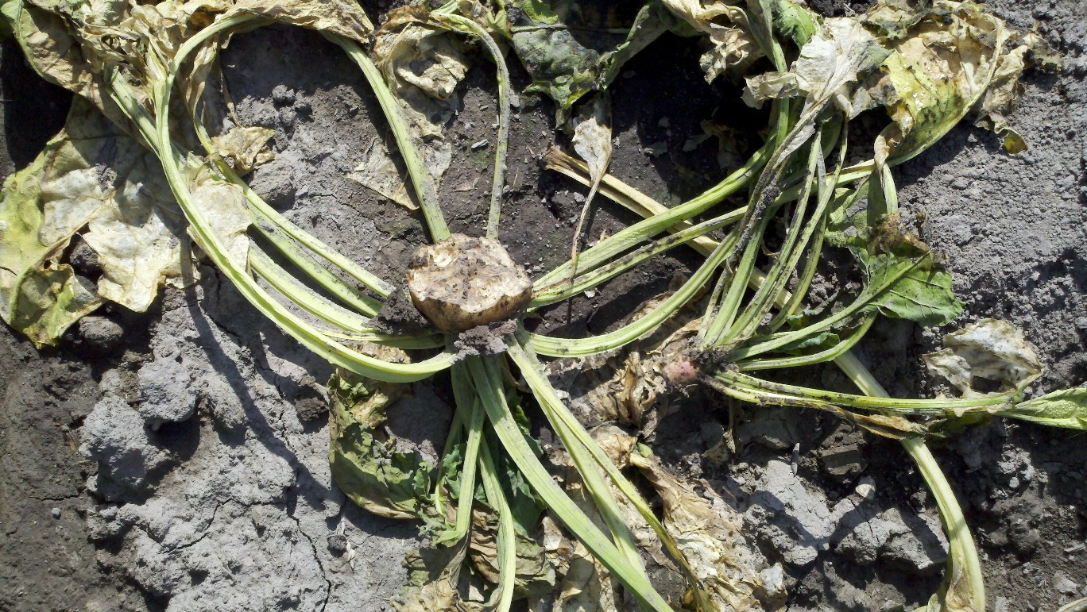
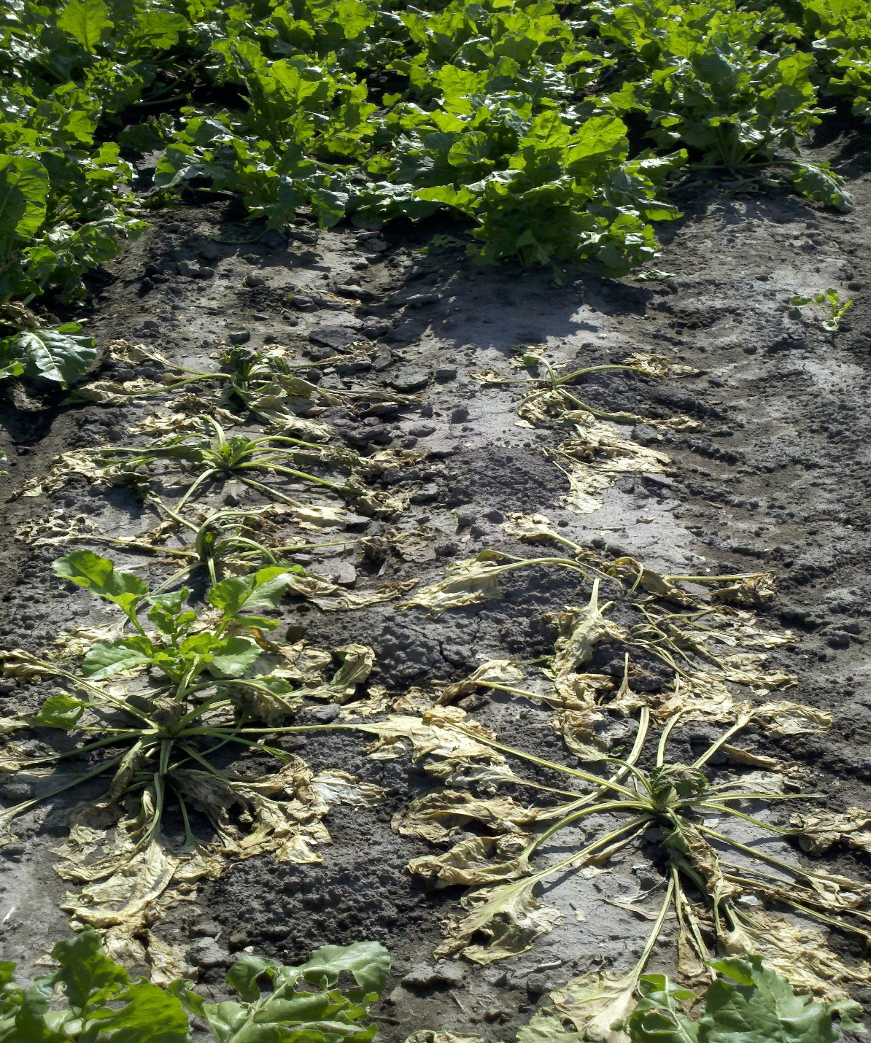
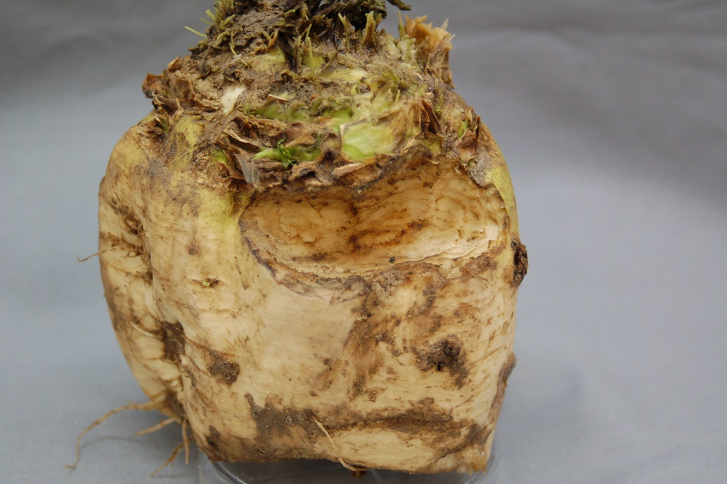
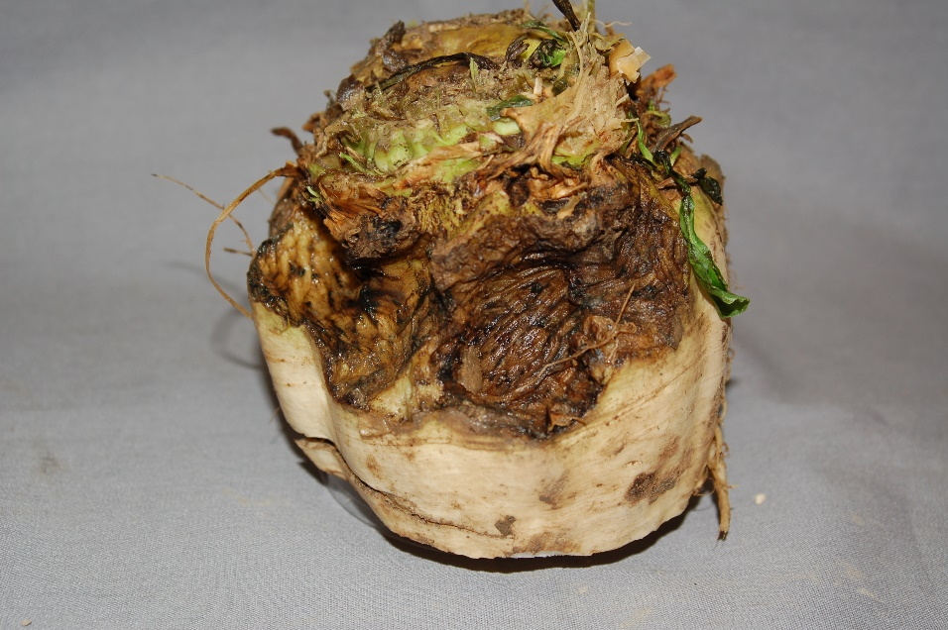

Slide 11
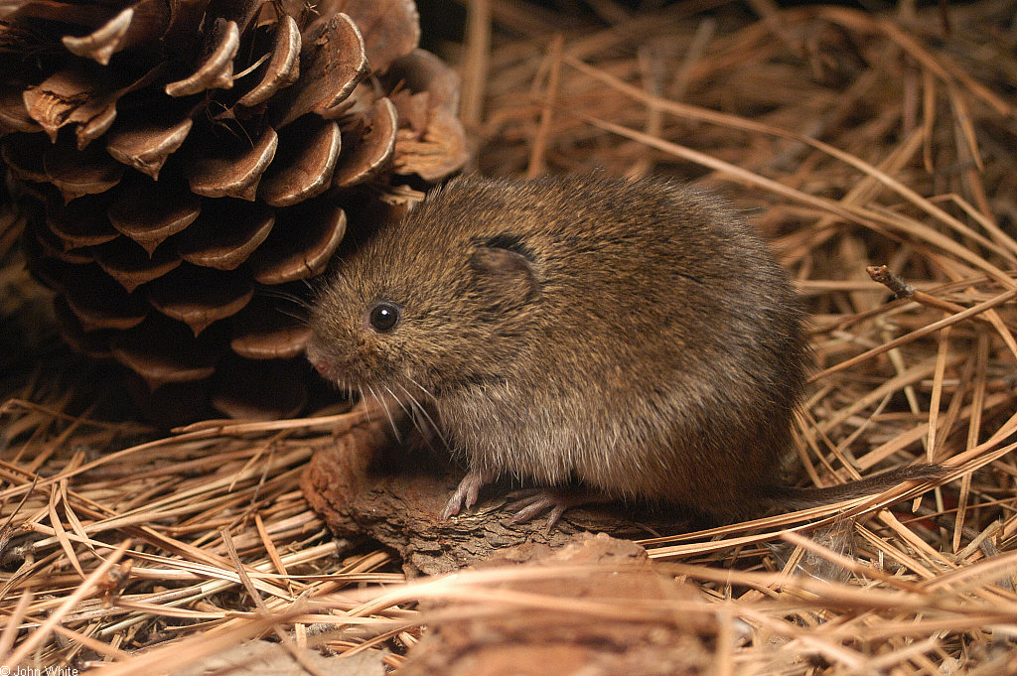
Vole Management:
Monitor area for signs of feeding activity from early spring to late fall
Habitat Modification
Plant Protection/Barriers
Trapping
Baiting with Rodenticides

Slide 12

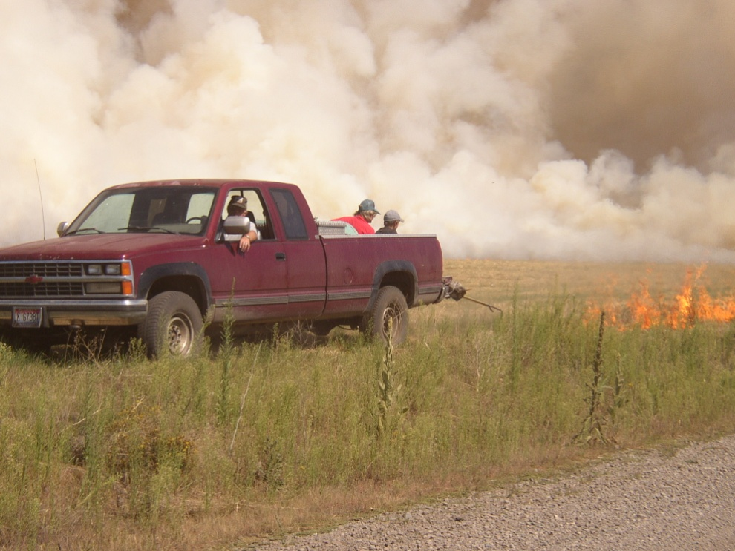
Habitat Modification—Reduce Vegetative Cover
Mow or burn ditch banks, barrow pits, and fence lines.
Clear weeds and debris
Graze or mow alfalfa and pastures in the late fall
Plow, disk, rake, burn, and remove snow
Develop weed-free cultivated buffer strips around large acreages. This is an effective technique, if practical.

Slide 13
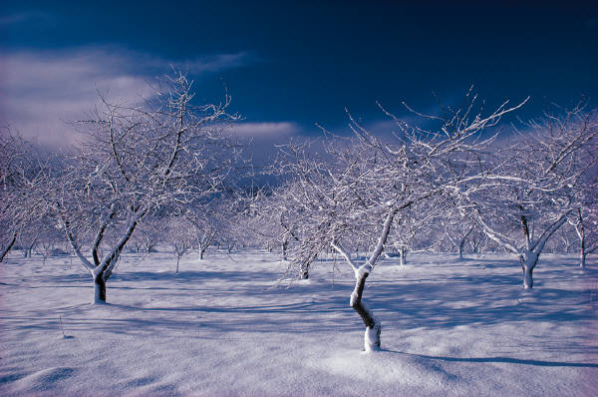
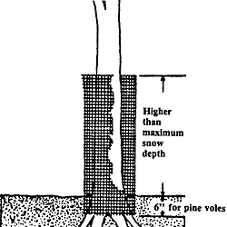
Tree Protection/Barriers
Screens and wraps will protect young trees
Protection must be higher than the maximum snow depth
3/8” netted wire 6” above and below soil level will protect trees and shrubs
Difficult for large number of trees

Slide 14
Trapping
Use of wooden mouse traps
Not practical for large infestations or large areas

Slide 15
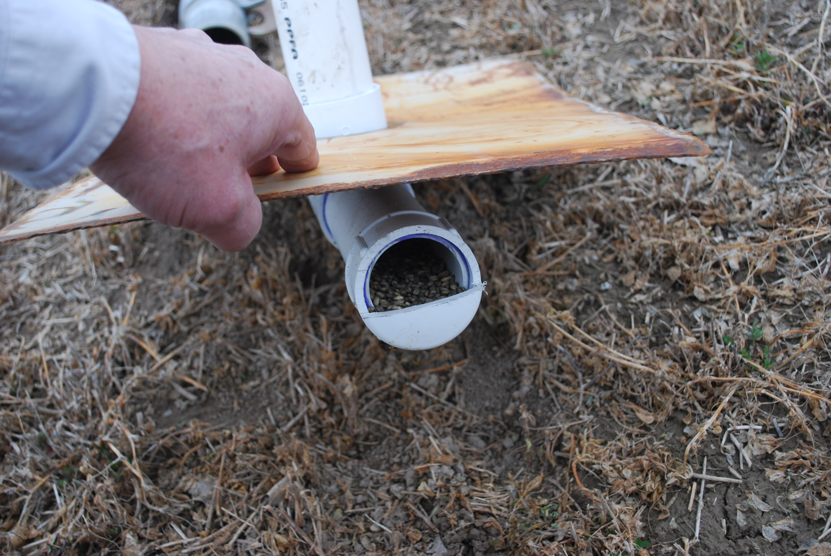
Baiting with Rodenticides
Most effective management practice for large populations
  a. When habitat manipulation is not possible
  b. When extensive vole damage is present
Zinc phosphide can be applied as a broadcast treatment for some crops
Most effective in late fall, early winter, and spring when green vegetation is low
Use bait stations where non-target poisoning might be a concern

Slide 16
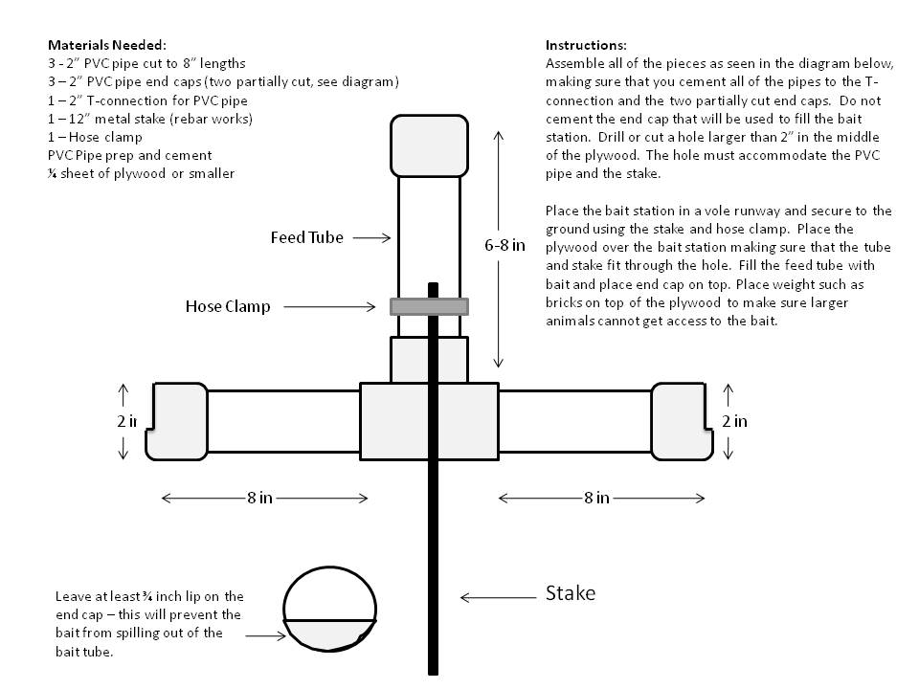
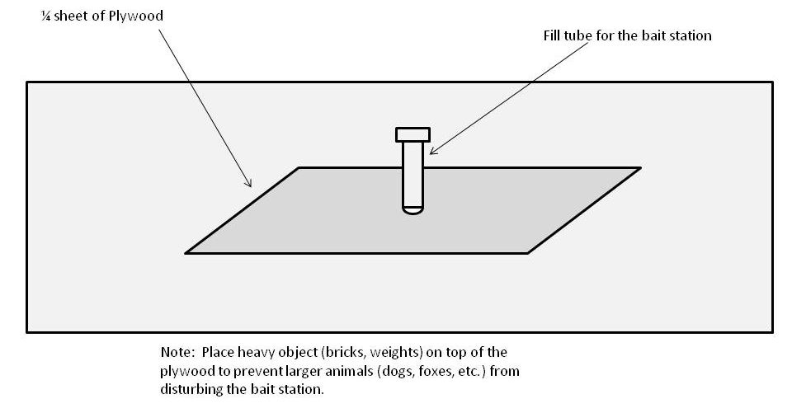
Bait Station Construction
Diagrams by Sherman Takatori

Slide 17
Rodenticide baits labeled for vole control
Zinc Phosphide
1st generation anticoagulants
Natural products, repellents (homeowner use)

Slide 18
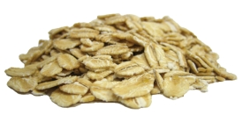
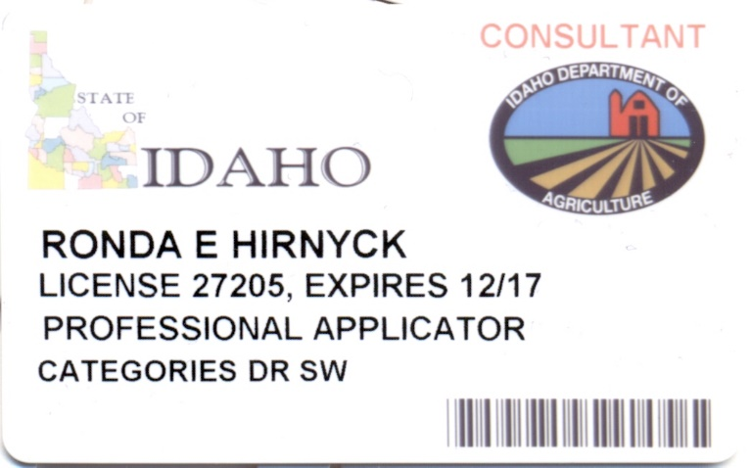
Zinc Phosphide
Prozap® and ZP AG®
Agricultural use products are RUP—need an applicator’s license
Some products are labeled for home and garden GUP—below ground or bait station applications only
Be sure to read the label for the product you plan to purchase and use

Slide 19
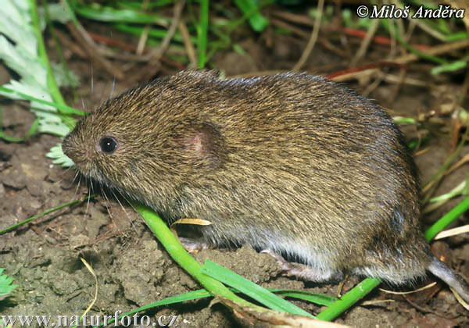
Zinc Phosphide
Broadcast applications allowed in sugar beet, barley, wheat, triticale, alfalfa, potato, dry bean, non-crop areas and rights-of-ways, and non-residential lawns.
Can place bait in runways or next to burrows, if not broadcasting.
Moisture activates zinc phosphide, rendering it ineffective
Voles feeding on the bait that do not die may become “bait shy”
Works very quickly, within 12 hours
Bury dead voles—wear gloves!

Slide 20
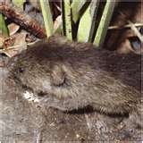
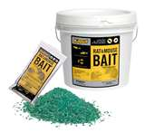
Zinc Phosphide Labeled Uses for Crops
Broadcast applications: 2 applications/year (20# max)
Sugarbeet=Do NOT apply within 30 days of harvest
Wheat, Barley & Triticale=Do NOT apply within 50 days of harvest
Alfalfa=Apply shortly after cutting hay & prior to next cutting with 2” growth. Cannot use alfalfa from treated area until it is harvested
Potato=Do NOT apply with 30 days of harvest
Dry bean=Do NOT apply with 30 days of harvest
RUPs

Slide 21
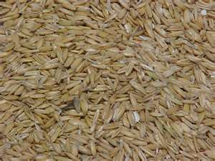
Baiting Success
1. Use fresh bait
2. Pre-bait
  a. Non-toxic bait
  b. Same size, shape, and formulation
May increase consumption

Slide 22

Non-Target Effects of Zinc Phosphide
Does not accumulate in body tissues
Predators or scavengers are not likely to be affected by eating poisoned rodents
ZP Bait is an acute toxicant and is toxic to children, pets, birds, and other animals
Store out of reach and use carefully to minimize access

Slide 23
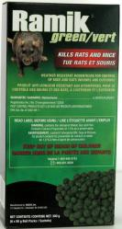
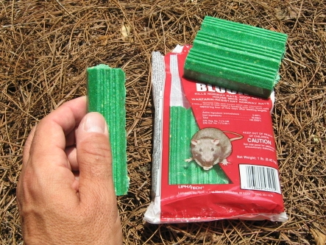
Anticoagulant Baits
Formulated using grain or other food sources
  Whole grain baits
  Pelleted baits
Moisture-resistant paraffin blocks
  Useful around ditches
  Areas where high moisture may cause other types of baits to spoil

Slide 24
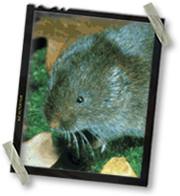
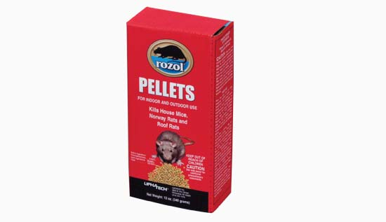
1st Generation Anticoagulants
Multiple feed
Residential use
Bait stations
Examples:
  Warfarin
  Diphacinone (Ramik Brown, Kaput-D)
  Chlorophacinone (Rozol)—Rozol Vole Bait is a RUP + some of the gopher baits

Slide 25
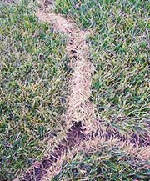
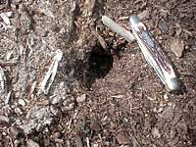
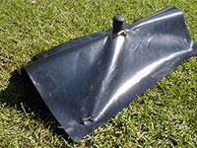
Anticoagulant Baits
Must be consumed over a period of days to be effective/continued baiting until population controlled
Cannot be applied directly to food or feed crops
Place in runways or near burrow openings
Can be used in areas adjacent to crop fields

Slide 26
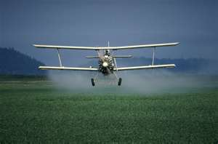
Rozol® Vole Bait
SLN 24(c) Registration
Aerial application
A RUP (anticoagulant)
Rangeland, non-crop areas, borders, buffer strips and center pivot corners to adjacent crops

Slide 27
SUMMARY
Voles are very prolific
Voles are active in the winter under the snow
Cannot use anticoagulant rodenticide/baits in gardens or food crops
Zinc phosphide fairly effective, but voles can become bait-shy
Multiple management practices are best for a long-term management strategy
UI Extension publication on vole and gopher management PNW 721

Slide 28
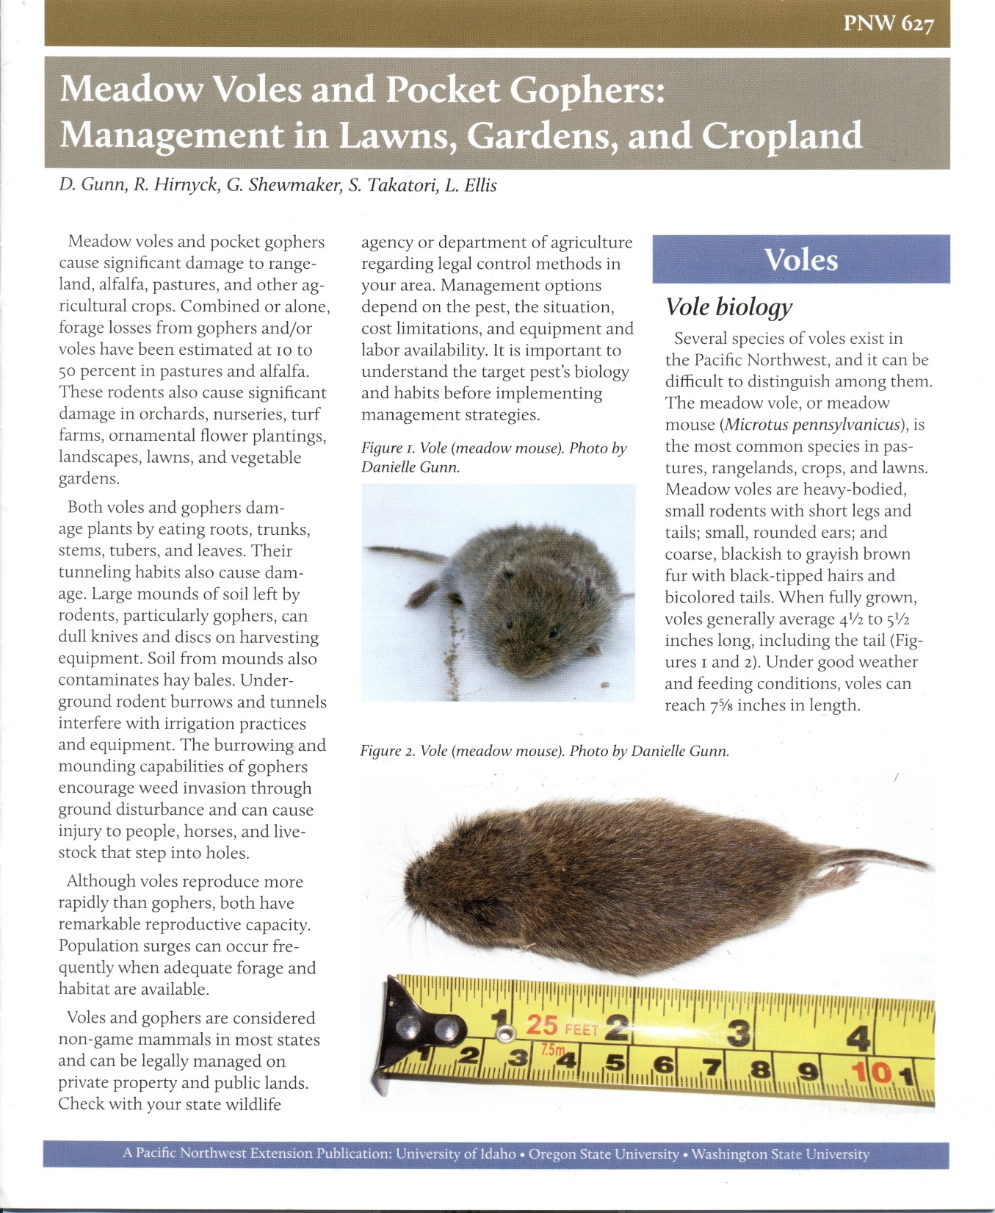

Slide 29
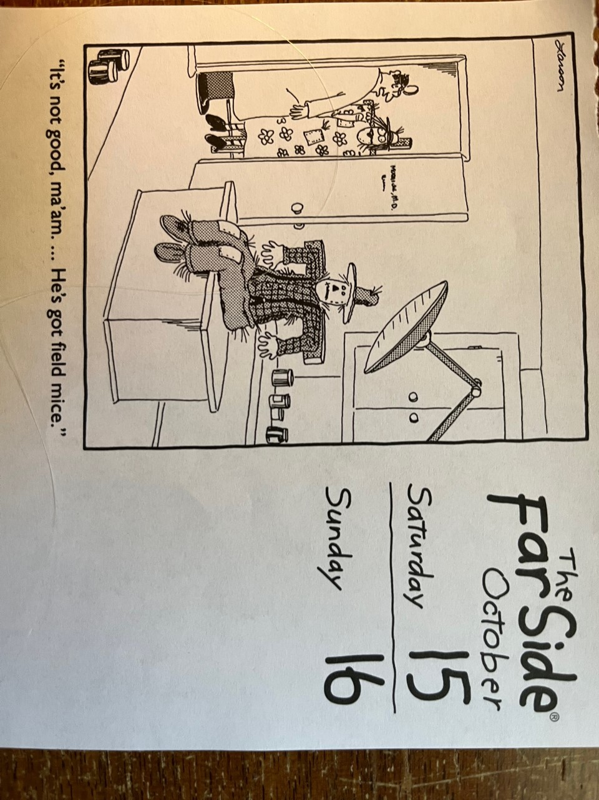
THANK YOU
Contact Info:
Ronda Hirnyck, Pesticide Coordinator
University of Idaho
rhirnyck@uidaho.edu

