Slide 1
Acreage Trends in Idaho
Trevor Knudsen
AVP – Appraisal Services

Slide 2
Topics
Irrigation Method Trends
Agricultural Acreage Trends
Land Value Trends

Slide 3
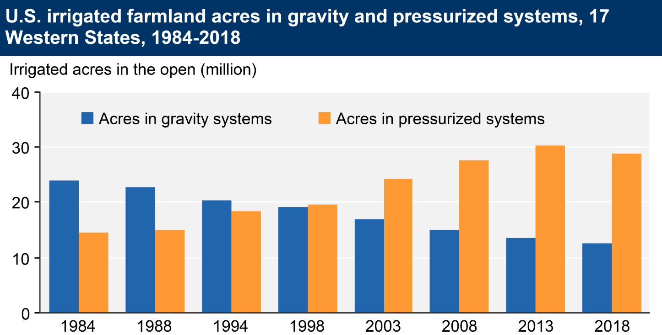
Irrigation Methods
Notes:
Million acre feet per year

Slide 4
Irrigation Methods in Idaho
Notes:
Million acre feet per year
Anecdotally, in the Pleasant Valley some folks ripped out pivots to put in wheel lines
Moving more towards pivot due to labor issues rather than water efficiencies

Slide 5
Agricultural Acreage Trends

Slide 6
Idaho Population
Idaho’s population grew by 21% between 2010 and 2021
US population grew by 7.3% in the same time period
2nd fastest growing state in 2022 (Florida is number 1)
Notes:
Data is from USA Facts.com which relies on government reported data: https://usafacts.org/data/topics/people-society/population-and-demographics/our-changing-population/state/idaho?endDate=2021-01-01&startDate=2010-01-01

Slide 7
Idaho Population
Twin Falls County’s population grew by 19%
Jerome County’s population grew by 9.9%
Cassia County’s population grew by 9%
Notes:
Data is from USA Facts.com which relies on government reported data: https://usafacts.org/data/topics/people-society/population-and-demographics/our-changing-population/state/idaho?endDate=2021-01-01&startDate=2010-01-01

Slide 8
Idaho Population
Ada County’s population grew by 30.1%
Canyon County’s population grew by 28.4%
Boise was 3rd fasted growing city in 2022 in USA
Notes:
Data is from USA Facts.com which relies on government reported data: https://usafacts.org/data/topics/people-society/population-and-demographics/our-changing-population/state/idaho?endDate=2021-01-01&startDate=2010-01-01

Slide 9
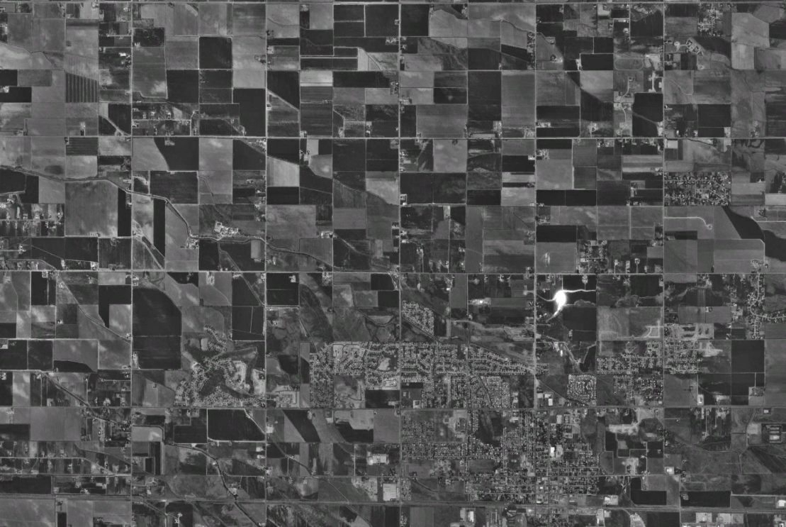
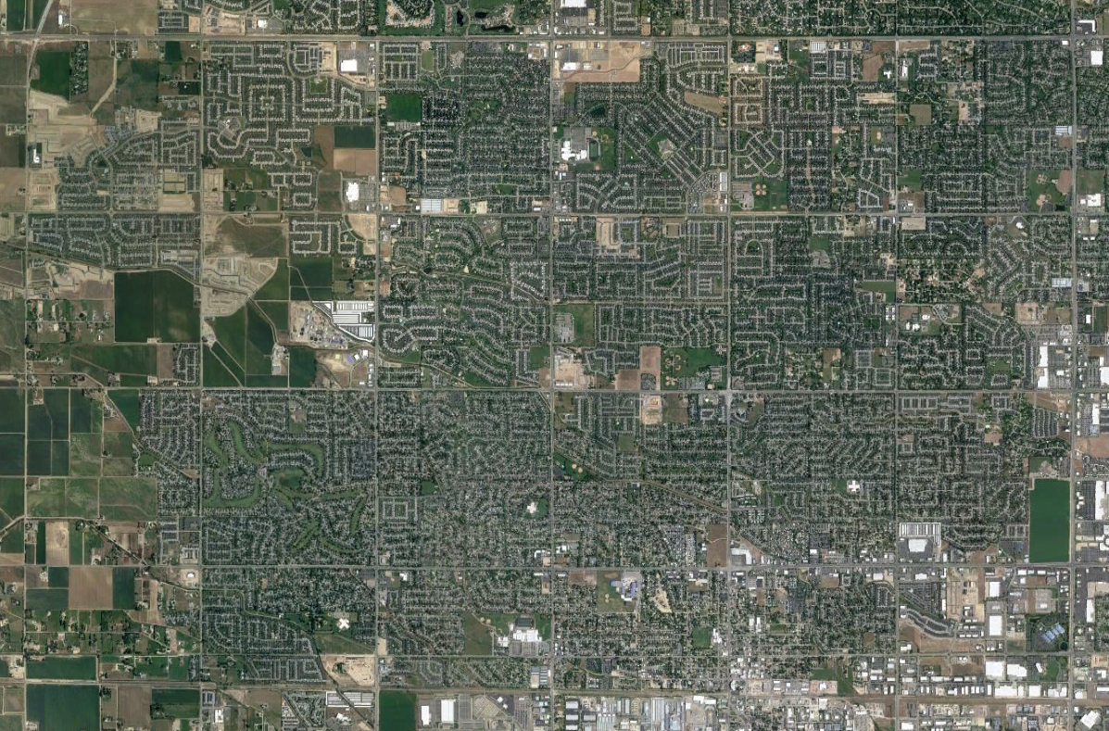
Idaho Population – Treasure Valley
1992
1992 Population: 309,532
2021
2021 Population: 755,046
Notes:
Data is from USA Facts.com which relies on government reported data: https://usafacts.org/data/topics/people-society/population-and-demographics/our-changing-population/state/idaho?endDate=2021-01-01&startDate=2010-01-01

Slide 10
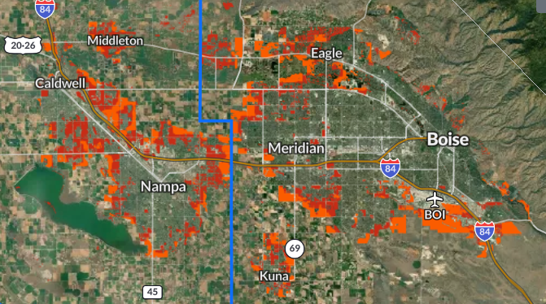
Idaho Population – Treasure Valley
Notes:
The colors in orange and red represent the projected land loss in the Treasure Valley by 2040, If “business continues as usual”.

Slide 11
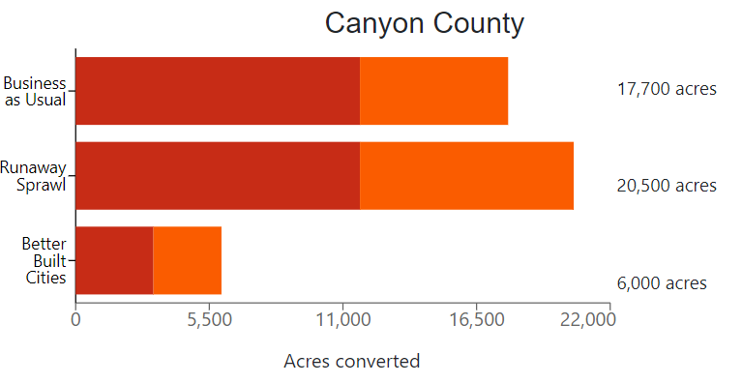

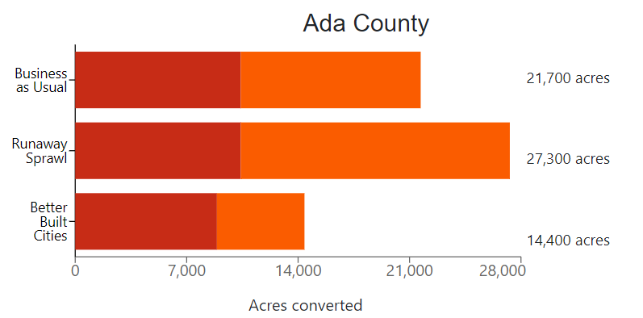
Idaho Population – Treasure Valley
American Farmland Trust Tool
http://development2040.farmland.org/
Notes:
American Farmland Trust did a study and came up with varying scenarios. Business as usual follows trends that have been seen, Runaway Sprawl represents what could happen with poor planning. Better Build Cities is with strong planning, limited development and encroachment of farmland.
Impact of acreage loss
http://development2040.farmland.org/
Meta data:
https://americanfarmlandtrust.sharepoint.com/sites/AFTGIS/Shared%20Documents/Forms/AllItems.aspx?id=%2Fsites%2FAFTGIS%2FShared%20Documents%2FFUT2040%2DLayers%2FDevelopment&p=true&ga=1

Slide 12
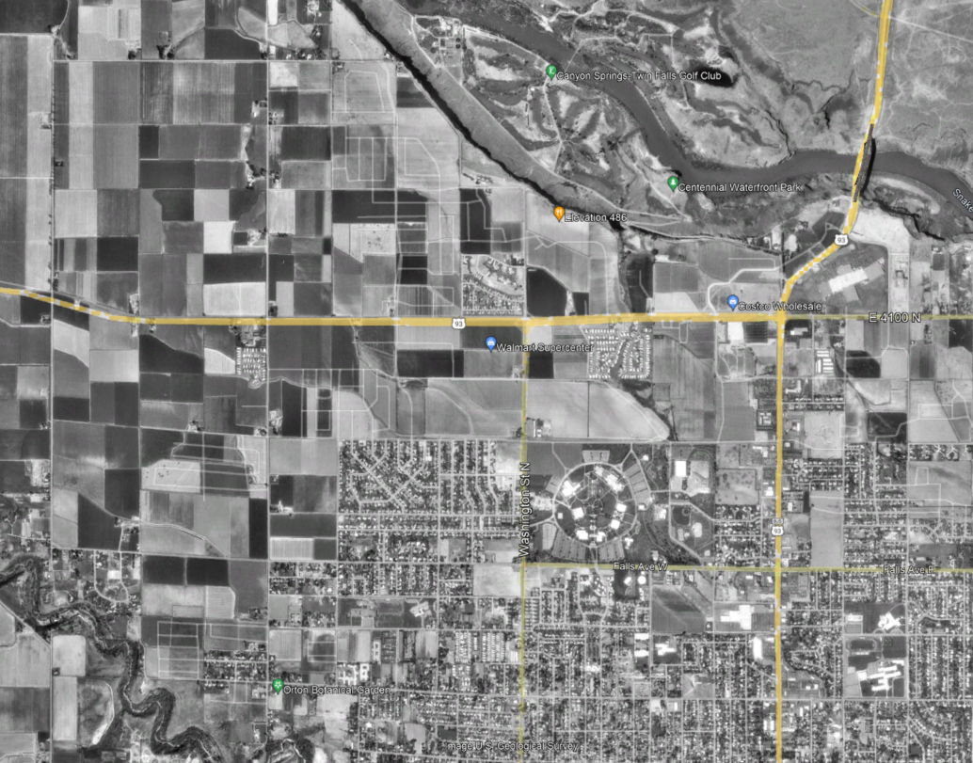
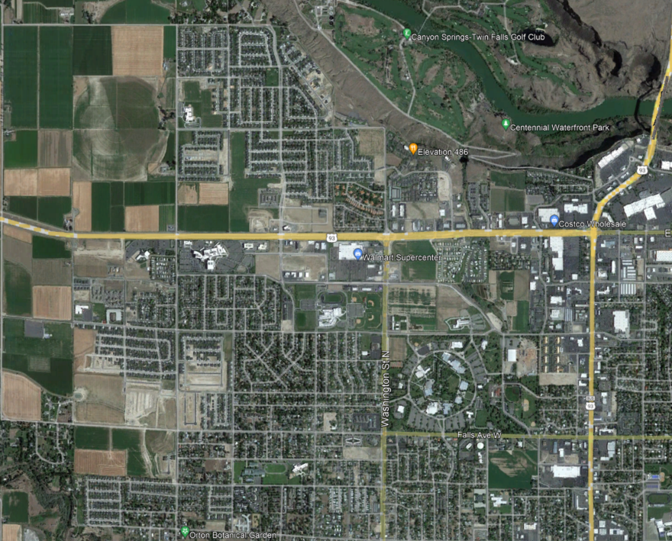
Idaho Population – Magic Valley
1993
1993 Population: 91,916
2021
2021 Population: 142,069
Notes:
Data is from USA Facts.com which relies on government reported data: https://usafacts.org/data/topics/people-society/population-and-demographics/our-changing-population/state/idaho?endDate=2021-01-01&startDate=2010-01-01

Slide 13
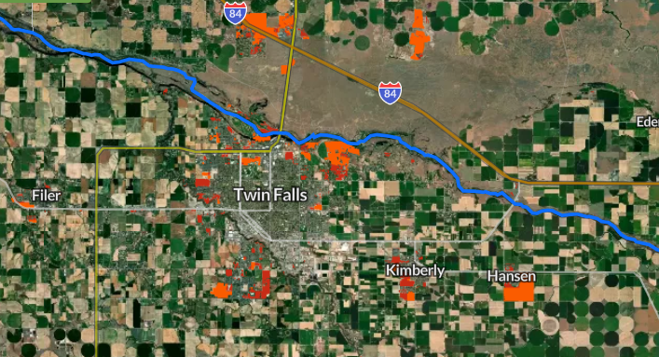
Idaho Population – Magic Valley
Notes:
The colors in orange and red represent the projected land loss in Twin Falls County by 2040, in an urban sprawl situation. Approximately 4,500 acres would be lost in this scenario

Slide 14
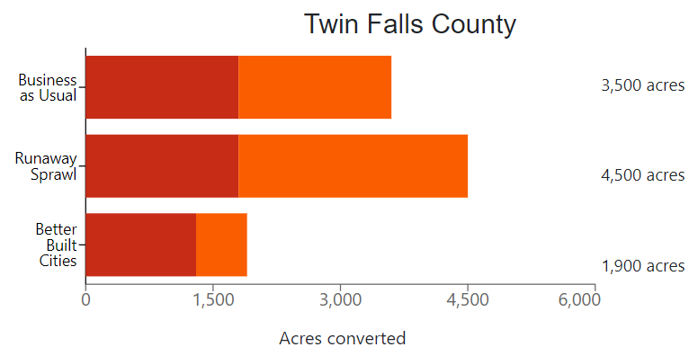
Idaho Population – Magic Valley
American Farmland Trust Tool
http://development2040.farmland.org/
Notes:
American Farmland Trust did a study and came up with varying scenarios. Business as usual follows trends that have been seen, Runaway Sprawl represents what could happen with poor planning. Better Build Cities is with strong planning, limited development and encroachment of farmland.
Impact of acreage loss
http://development2040.farmland.org/
Meta data:
https://americanfarmlandtrust.sharepoint.com/sites/AFTGIS/Shared%20Documents/Forms/AllItems.aspx?id=%2Fsites%2FAFTGIS%2FShared%20Documents%2FFUT2040%2DLayers%2FDevelopment&p=true&ga=1

Slide 15
Agricultural Acres in Idaho
Over 68,000 agricultural acres were lost between 2012 and 2017 (census years)
About 50,000 acres were lost in Treasure Valley during that timeframe
Magic Valley agricultural acres were stable*
Notes:
2012 and 2017 are from the Census. 2021 is a Census year, but that data will not likely be released until early spring 2023. The figure comes from the USDA, but may not be completely accurate.
2012 and 2017 information comes from Census, 2021 data is from USDA Economics, Statistics and Market Information System
2012-2017 – ag acres in TF and Jerome dropped by 30,000 acres, while Cassia County increased by about 30,000 acres – redistribution

Slide 16
Irrigated Acres by Region
NOTE: 2021 acreages are based on several assumptions
Magic Valley agricultural acres were stable*

Slide 17
Agricultural Acres in Idaho
Takeaways
Agricultural land loss will continue in Idaho
High interest rates have slowed development
  Timing of slowdown is uncertain
Possible mitigation includes proper planning and zoning
  Get involved in your communities
  Explain why prime agricultural land needs to stay in agricultural production
Notes:
2012 and 2017 are from the Census. 2021 is a Census year, but that data will not likely be released until early spring 2023. The figure comes from the USDA, but may not be completely accurate.
2012 and 2017 information comes from Census, 2021 data is from USDA Economics, Statistics and Market Information System
2012-2017 – ag acres in TF and Jerome dropped by 30,000 acres, while Cassia County increased by about 30,000 acres - redistribution

Slide 18
Land Value Trends

Slide 19
Land Value Trends

Slide 20
Land Value Trends

Slide 21
Land Value Trends
(All Sales)
(Top and Bottom 10% Removed)

Slide 22
Land Value Trends

Slide 23
Land Value Trends
(All Sales)
(Top and Bottom 10% Removed)

Slide 24
Land Value Trends
“Buy land, they’re not making any more of it.”
-Mark Twain
“Land is the only thing in the world that amounts to anything, for it's the only thing in this world that lasts. It's the only thing worth working for, worth fighting for, worth dying for.”
-Margaret Mitchell
Notes:
Show me a piece of ground that is worth less today than it was 25 years ago.

