Slide 1
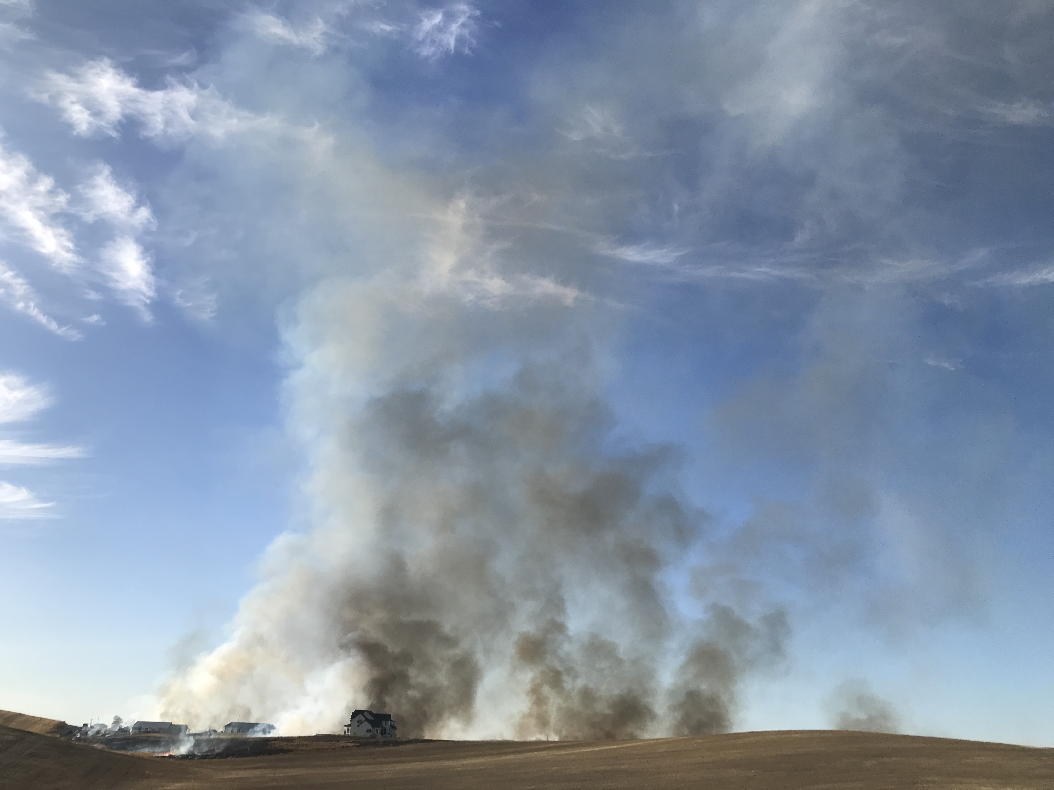
Crop Residue Burning Program
Bean School 2023 – Twin Falls
Heidi Orr
Air Quality Compliance Officer

Slide 2
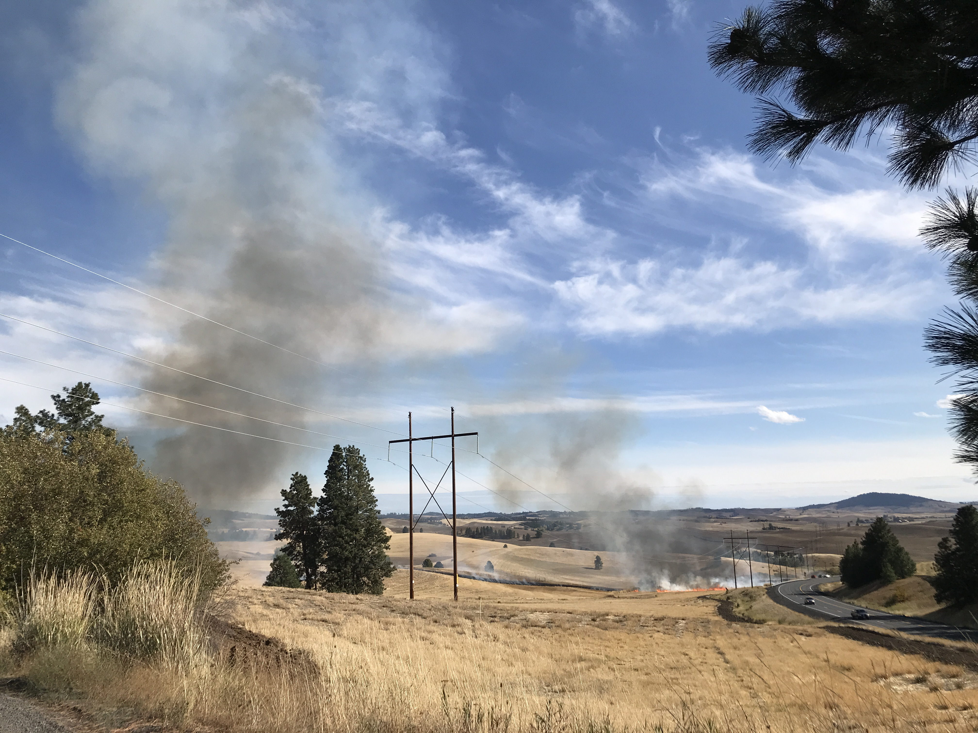
Program History
Current program developed from 2007 settlement agreement.
Nez Perce Tribe and Washington DOE programs served as models.
Focus on Sensitive Populations
Must meet Clean Air Act requirements
Statute, Rule, and Op Guide
Changes over time:
  Spot and Bale, Propane Flaming
  Pollutant Threshold Criteria- Ozone
  Fee due date – Pay at the end of the year.
  Op Guide Updates

Slide 3
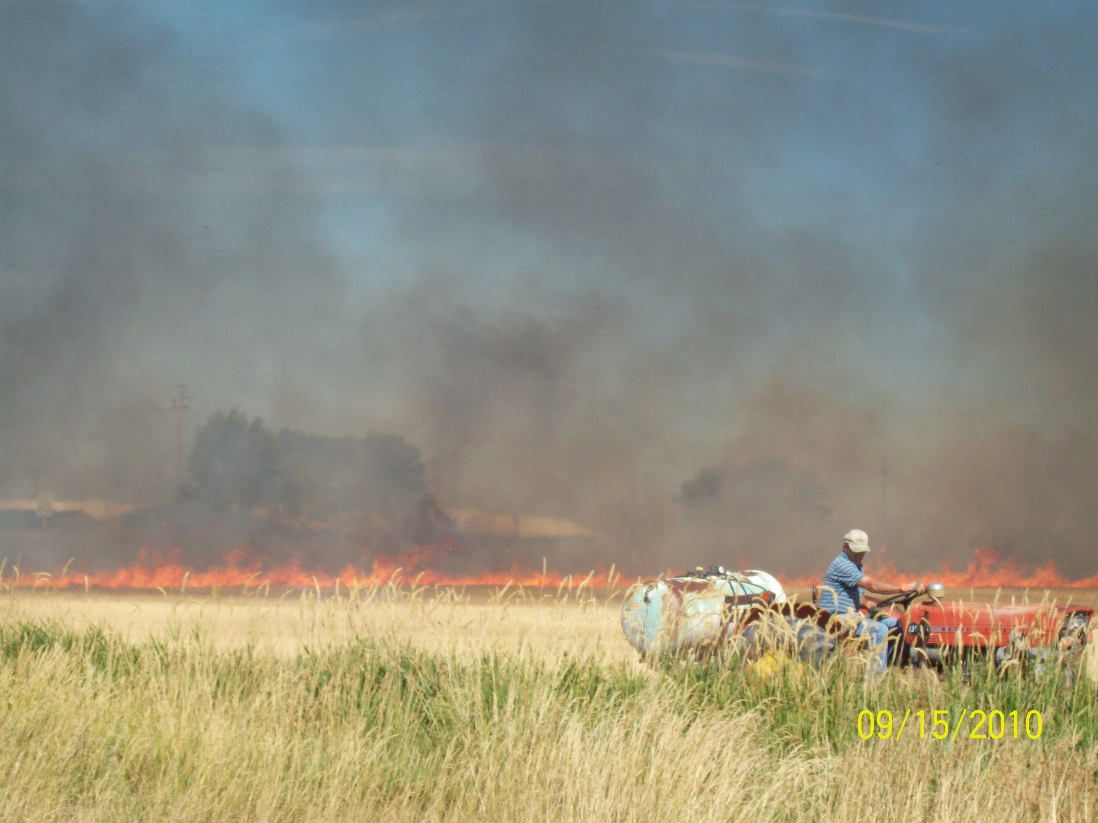
Want to Burn? Here’s How!
Register before you want to burn (At least 3 days)
Take Grower Training (Once every 5 years)
Add field to Ready to Burn list
(At least 24 hours prior)
Day of burn - Get approval from DEQ
Submit post burn report.
Pay fees next January ($2 per acre).

Slide 4
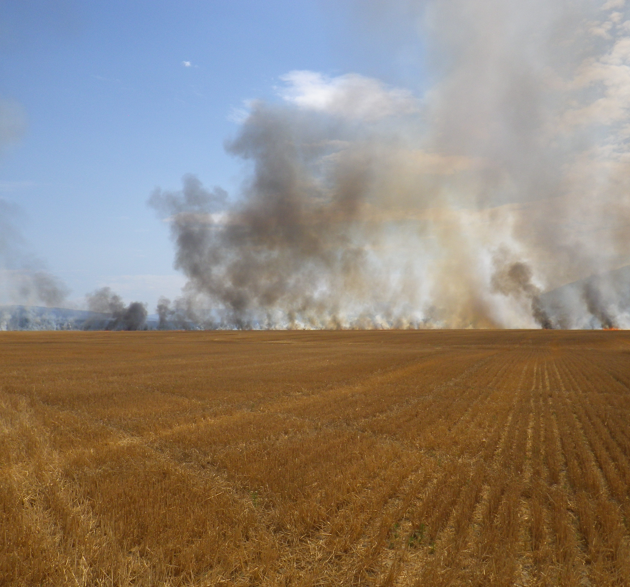
Program Goals
Ensure protection of air quality and public health
Protect fire as a resource management tool
Collaboration between agency partners, growers and the public

Slide 5
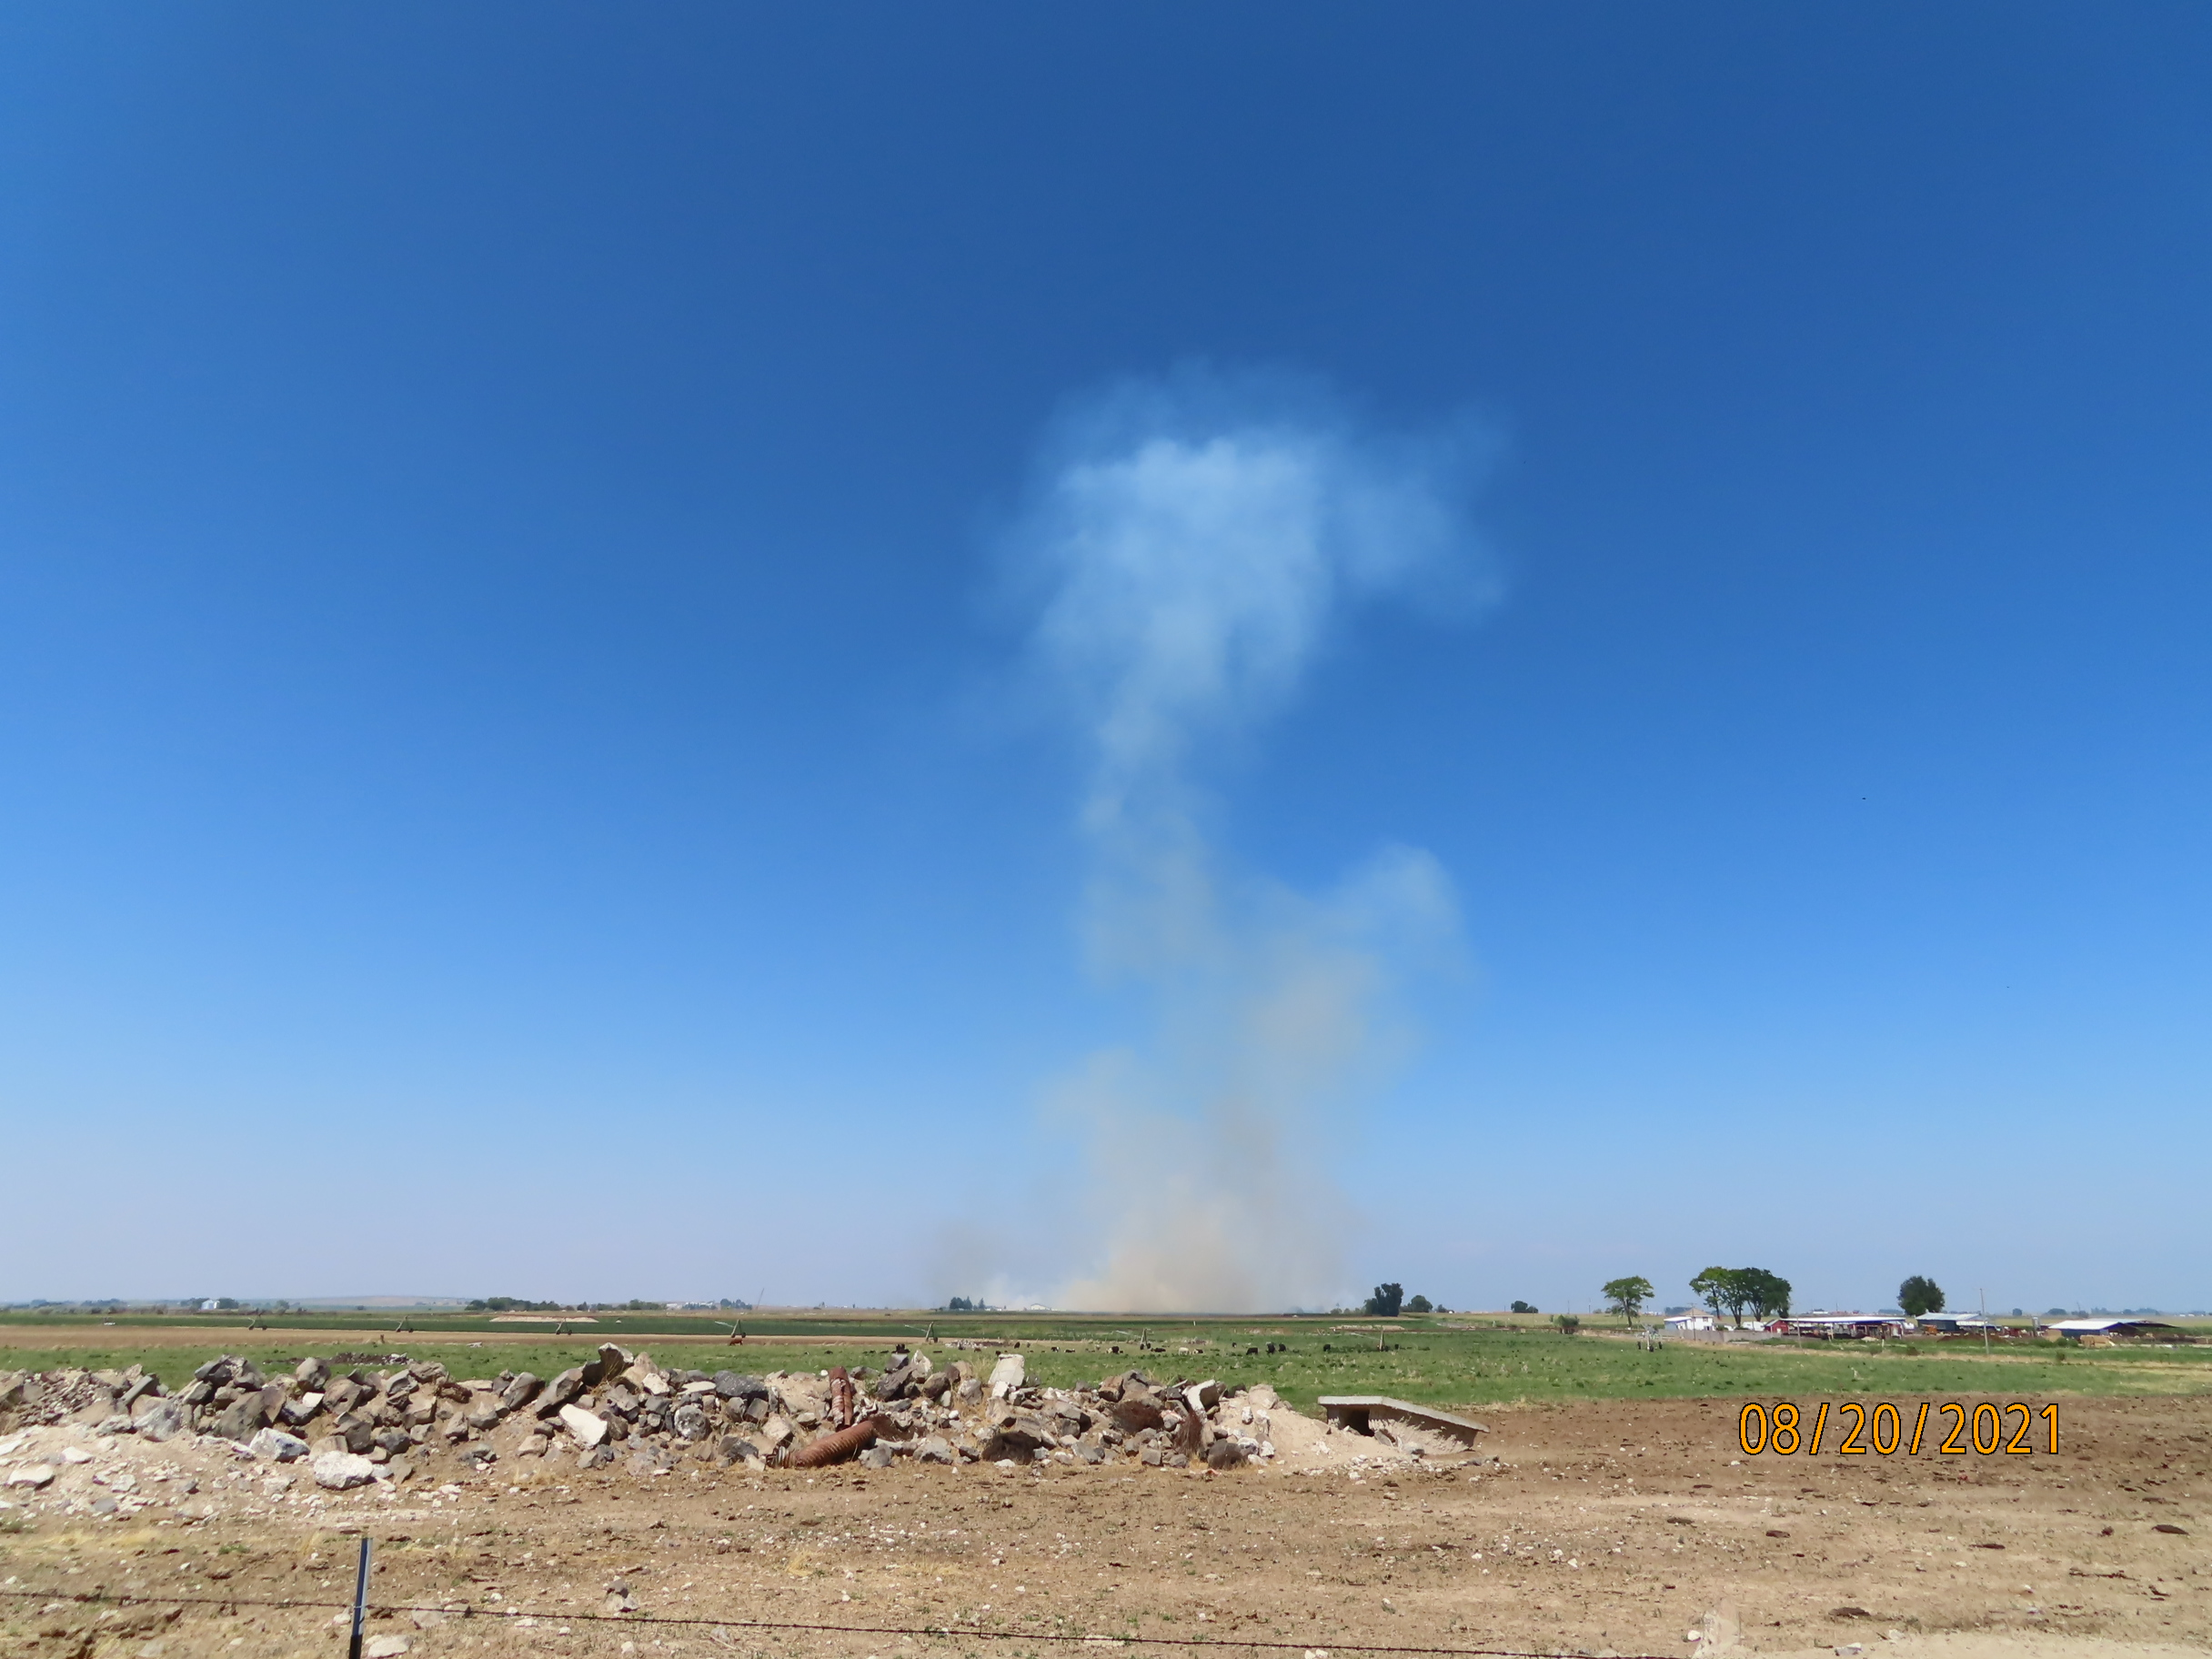
Advisory Committee
Meets annually to discuss, prior year’s burning, updates and suggested changes to the program
Consists of Growers, Environmental Organizations, Health Organizations, Tribal Partners, ISDA, EPA and DEQ
South Central Grower Representative: Lucas Spratling
Next Meeting: February 23, 2023

Slide 6
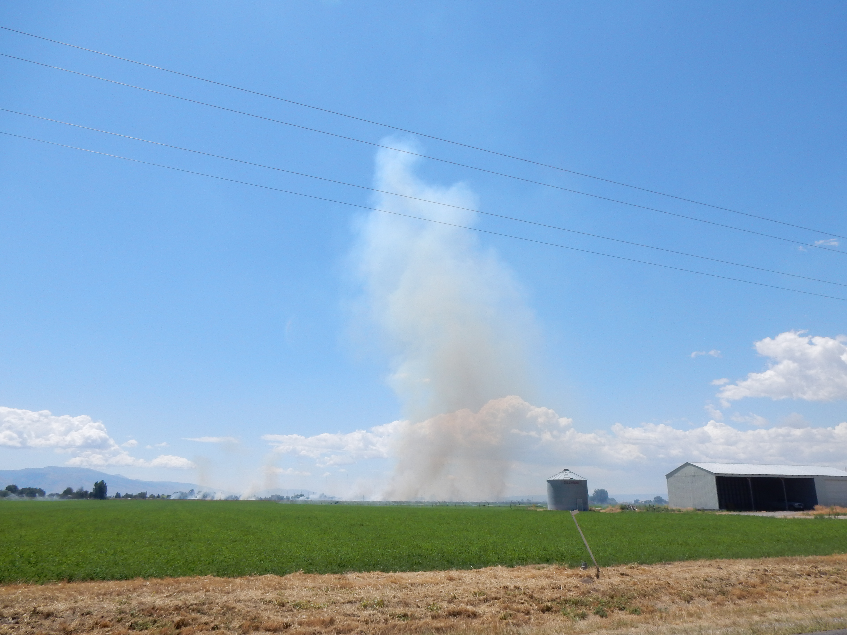
Contact Us!!
Heidi Orr
Twin Falls Regional Office 208-736-2190
Heidi.Orr@deq.Idaho.gov

Slide 7
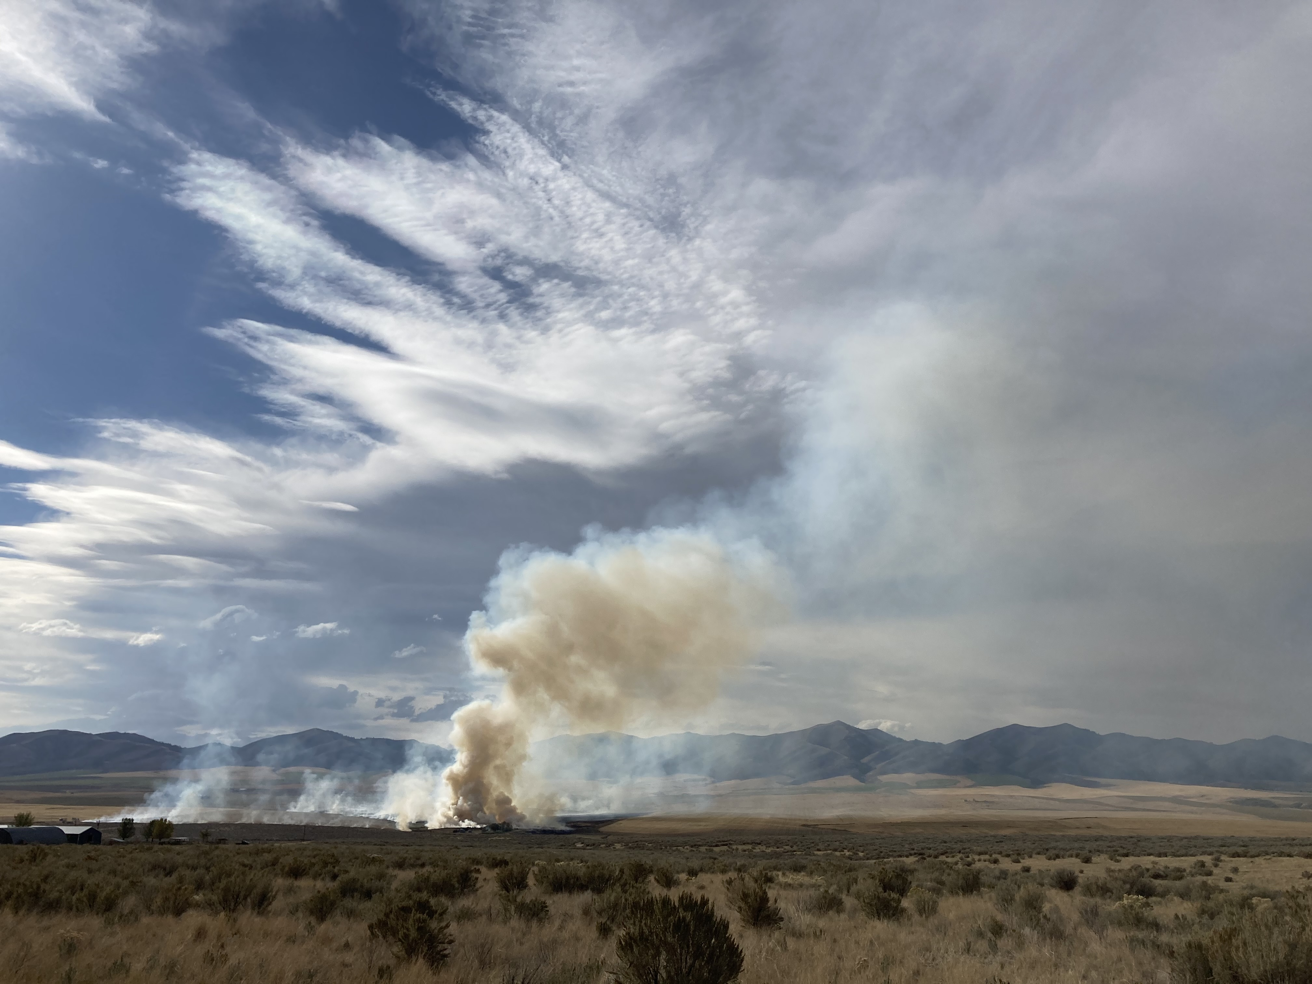
Thank you
Heidi Orr
Air Quality Compliance Officer

