Slide 1
Idaho Bean School NAMPA Jan 23, 2024
Input trends

Slide 2
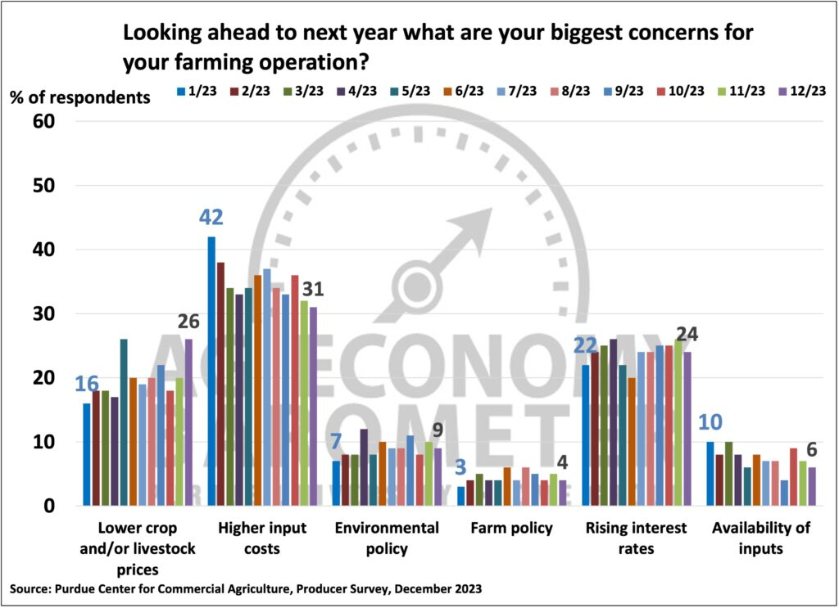
Input concerns are top of mind…
Should they be?
Notes:
USDA ERS projects all input costs will be up only 3.5% on average, for all commodities, in 2024

Slide 3
Input cost updates
Fuel and electricity costs
Fertilizer and chemical costs
Interest expenses
Farmland value and rental rate
Machinery
Hired labor
Notes:
We will discuss the input costs of these categories,
Fuel and eletrictity
Fertlizer and checmical
Interest Rate
Farmland price snad rental rate
Machinery,
And last but not least, feed costs.

Slide 4
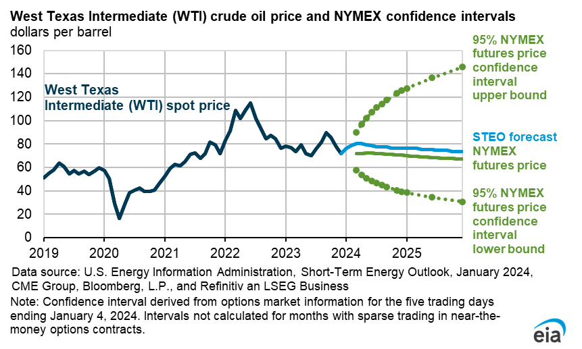
Forecast

Slide 5
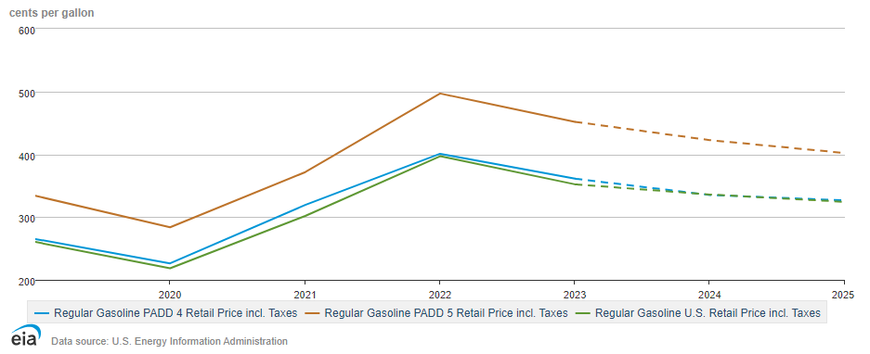
Regional Retail Gasoline Prices
Forecast
Notes:
https://www.eia.gov/outlooks/steo/data/browser/

Slide 6
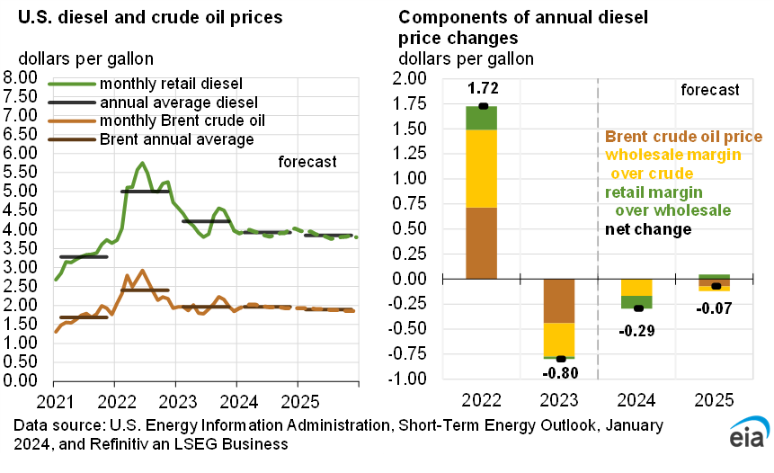

Slide 7
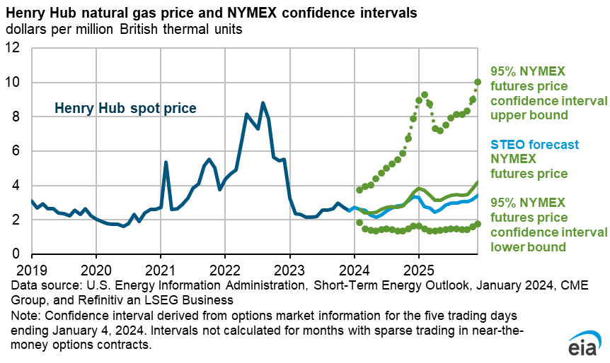
Forecast

Slide 8
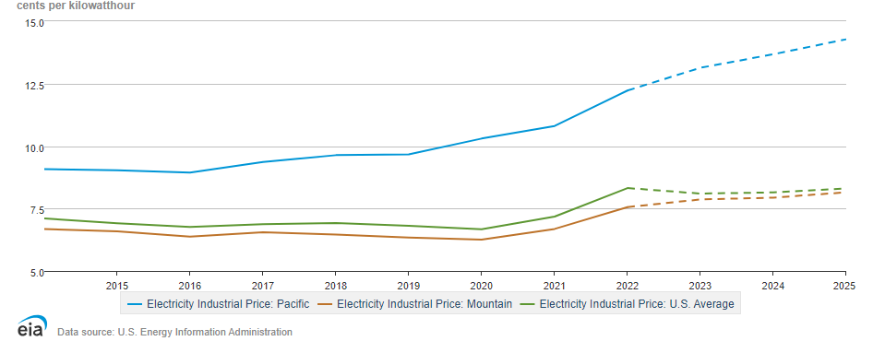
Regional Electricity Prices - Industrial
Forecast

Slide 9
Fertilizer prices likely further decline
Source: USDA AMS
Notes:
Natural gas prices also affect the prices of nitrogen-based fertilizer. In most of the countries, natural gas is the main feedstock for nitrogen fertilizers, so a lower natural gas prices naturally means that nitrogen price would also go down.
Meanwhile, because fertilizer prices were so high in 2022, producer worldwide had lowered fertilizer consumption by almost 7% because of the affordability issue.
The increased supply, due to lower natural gas prices, combined with lower demand, has led to a dramatic downturn in fertilizer prices.
The chart here shows the fertilizer prices in the US Midwest, where we have access to data back to the pre-pandemic period. We can see that Anhydrous Ammonia and Potash both dropped by 40% in the last 12 months, and Urea prices dropped by 30%, and DAP prices declined by a quarter in the last 12 months.
and the pre of potash started to decline in December 2022, while the price for phosphate, declined more slowly, and the real drop did not begin

Slide 10
Reasons for declining fertilizer prices
Market adjusted to disruptions from Russia-Ukraine war
Lower natural gas prices
Expanding fertilizer production capacities that have either come online or expected to be online soon
US lowers tariffs on Moroccan phosphate fertilizers (~20%→2%)
7% lower fertilizer consumption in 2023 because of low affordability
Notes:
As the saying goes “the cure for high prices, is high prices”,
Morocco and Russia were unfairly subsidizing their phosphate exports and flooding the U.S. market.

Slide 11
Fertilizer prices: uncertainty remains
PNW MAP (11% N 52% Phosphate)
13% last 12 months
PNW liquified nitrogen (32% N)
16% last 12 months
PNW white potash (62% K)
24% last 12 months
PNW Urea
30% last 12 months
PNW red potash (60% K)
38% last 12 months
Source: USDA AMS
Notes:
Looking at the fertilizer market in the pacific northwest, where we only had data starting from October 2022,
We can see largely similar pattern as the Midwest, except that pries are a lot more stale, compared to midwestern prices.
Starting with nitrogen, liquified nitrogen price only dropped 16% in the last 12 months, but urea price dropped by 30%, same as in the Midwest.
For Potash, we have red and white, red potash price declined by 24%, and red potash dropped by nearly 40%, which again is similar in magnitude as the Midwest.
However, the phosphate price in PNW has only declined by 13% in the last 12 months, while in Illinois it dropped by 25%. So a much lower magnitude of price
Fertilizer prices were already going up before the war because of strong demand, but the sancation on Russia and Belarus expoerts had made the things much worse.
The chart here shows the fertilizer prices in the US Midwest, where we have access to data.

Slide 12
Factors affecting fertilizer prices in 2024
Demand factors
Corn vs. Soybean acreage in the US
Weak grain prices expected in 2024
Supply factors
Natural gas prices
Production and transportation issues in the US
World events → Middle East conflict?
About 51% of global urea exports come from the Middle East region
Israel is the world’s 4TH largest producer of potash
Notes:
Looking ahead, we are likely to see slightly similar or continued lower fertilizer prices in 2024.
From the demand side, How many corn acres are planted in the U.S. in 2024 could influence global fertilizer prices. Corn prices were low in 2023, and because of that
Most analysts believe more soybean acres will be planted in 2024, because soybeans have a better margins compared to corn. Some estimates in fact suggested that corn acreage may drop from 95 million acres in 2023 to 91 million acres in 2024. So less corn acreage means that there will be less fertilizer dmenad, and theirefor lower prices.
On the supply side, natural gas prices will be the key factor determining nitrogen fertilizer prices. US typically produce about 85% of the nitrogen fertilizer used in the US domestically, with the remainder coming from imports. US has been expanding its nitrogen fertilizer production capacity in over the past couple years, so availability will likely not be a issue in 2023, and given the forecast of natural gas prices in 2024, we will likely to see more fertilizer supply.
But, weather conditions can disrupt natural gas or nitrogen production, and there is also the possibiliby of supply chain issues affecting the transportation of nitrogen from production regions to use areas.
And lastly, while the world has largely abosorbed the impact from Russian Ukraine war, we have another big conflict, One situation that could alter the relative calm in the fertilizer market in 2024 is the continuing war between Israel and Hamas.
About 51% of global urea exports come from the Middle East region, and In addition, Israel is the world's fourth largest producer of potash fertilizer. If the conflict continues, it may cause risk to the fertilizer supply chain.
With that, we believe that fertilizer prices will be again lower in 2024, but lots of uncertainties remain. So what are some of the ways that producers can use to manage the fertilizer price risk. Number 1, you may want to apply fertilizer at the recmmonded levels, second. you could also price fertlizers multiple times during the year. Pricing fertilizer at multiple points will reduce the risk of pricing all at its highest point and will result in an average price closer to the average for the season
One of the biggest risk when buying high-priced fertilizer is the risk that the crop price goes down. You can mitigate this risk by Marketing a portion of the crop with fertilizer purchases.
Such scenarios must be considered, but they seem improbable to have large impacts. However, the prices of nitrogen fertilizers remain uncertain.
For some U.S. producers, they were able to avoid the surge in fertilizer prices caused by Russia’s invasion, because they purchased fertilizers for 2022 plantings in 2021. But for many, this had a huge toll on their enterprize budget, which my collauge Pat will discuss more later.
The good news is that over the summer, we see fertilizer prices coming down quite a bit, in particular urea prices, the gold line, the FOB price in middle east has dropped from 900 dollars per metric ton to almost 500.

Slide 13
Chemical prices May CONTUINE TO decline in 2024
Chemical price by 20% in last 12 months
Source: USDA NASS, https://www.nass.usda.gov/Charts_and_Maps/Agricultural_Prices/prod1.php, Nov 2023
Notes:
Similar to fertilizers, chemical prices were high in 2022. The high prices in 2022 was mostly driven by shipping backlogs, labor disruptions at the ports, trucking industry and production facilities, and China’s zero COVID policy and increasing environmental regulations, China is a big exporter of chemicals. .
In 2023, as China loosens its Covid policy and production picking up in North America,, we will see less shortage, , and the price of chemicals have dropped by 20% in the last 12 months.
Going into 2024, chemical prices will likely continue to decline. The strong prices in the past few years have led to sustained additional capacity, and we believe that the pressure from capacity additions could lead to an increase in supply, which will put downward pressure on checmical prices.
Where does it end? China's zero-COVID policy, which is aimed at eradicating the virus and could continue to force sudden production facility shutdowns, remains the biggest known risk to future supplies, Taylor noted.
But most likely, sometime in 2023, the acute nature of current shortages should ease, and we could see an abrupt "bullwhip" effect of swinging from scarcity to abundance, he said.
The pricing in the Chinese market, at the manufacturer level, is 100% up year-over-year," he noted. Add to that the inflated costs of shipping, land freight, and scarcity, and the result is customers facing soaring farm-gate prices, from $100 per gallon up to $130 per gallon, according to DTN's reporting. "Local retailers and smaller co-ops without the big purchasing power will have the most shortage of availability," Taylor warned.
Production is picking up a little bit in the North American market," he noted, after disruptions from Hurricane Ida in 2021.
Almost all the flex in the supply chain is now gone, explained Sam Taylor, executive director of RaboResearch. That means any little disruption -- an acreage swing of a few million acres, a bad storm, a factory going offline -- will have unusually large cascade effects. "Everything that might not have had an impact on the supply chain in the past is now going to because of the length of delays that have built up," Taylor explained.
One such event occurred in mid-September, which could affect 2022 glyphosate production, Taylor noted. New environmental requirements from the Chinese government have forced the Yunnan Province to drop its yellow phosphorus production to 10% of its normal capacity through December. The Yunnan Province can account for anywhere from 40% to 45% of China's yellow phosphorus production, which goes into finished phosphates and glyphosate production, Taylor said.
Overall, China's increased environmental regulations as it prepares for the 2022 Winter Olympics in Beijing could be a major constraint on global crop chemical inputs, Taylor warned. "There are more environmental production initiatives coming down on 2,4-D, glufosinate and other active ingredients," he said.

Slide 14
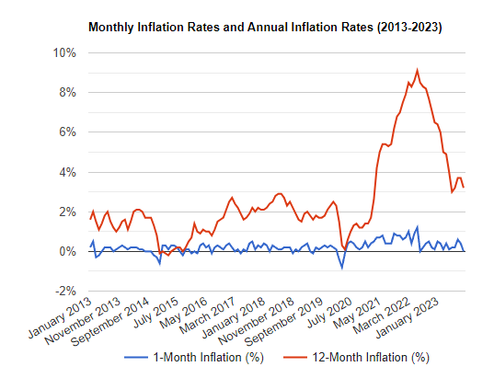
Big picture: inflation
Source: U.S. Bureau of Labor Statistics
Notes:
Another key economic event this year is the rising inflation in the US. Actually, throughout the world, we see crazy levels of inflation in almost all countries
The plot here shows the change in consumer price index, compared to the same month last year. Inflation hit 9.1%, earlier this year, and it has decreased somewhat in the third quarter. In October, the inflation was 7.7%, comparable to the level at the beginning of the year.

Slide 15
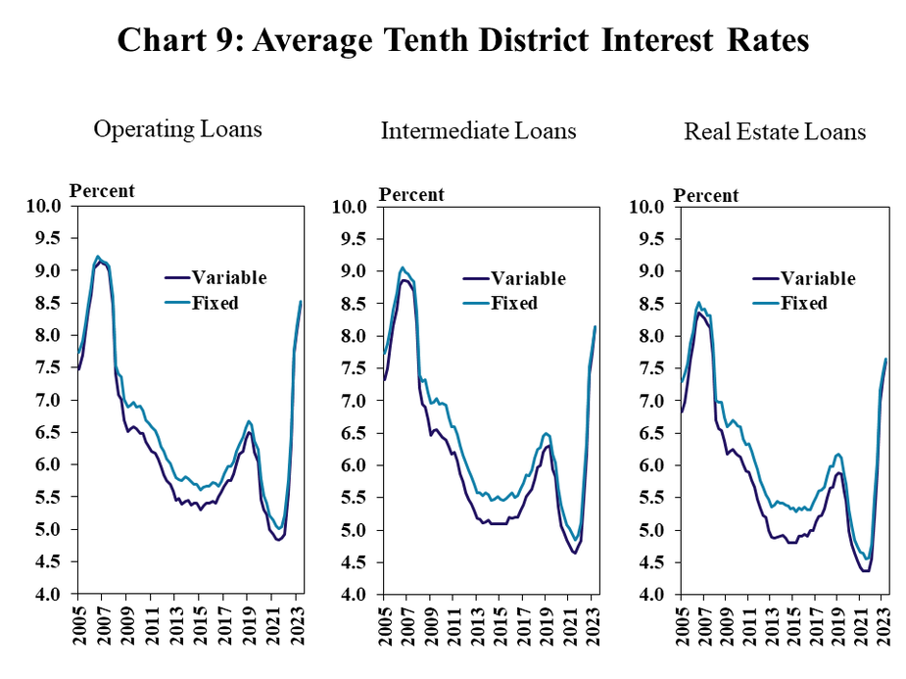
Notes:
KC Fed. DOES include Mtn Region

Slide 16
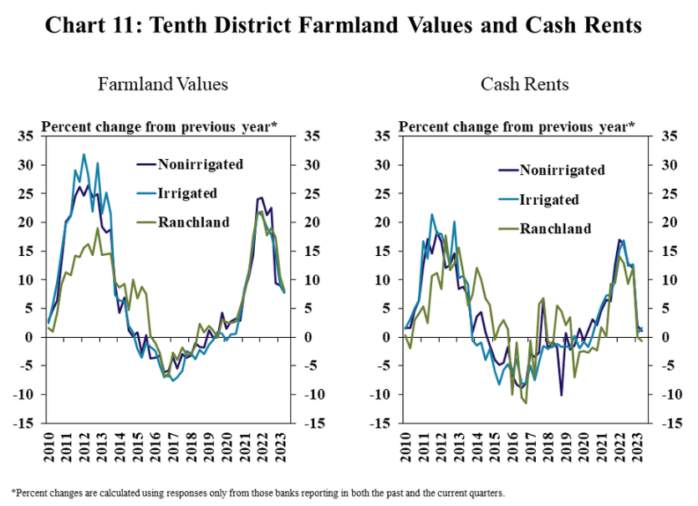
Notes:
KC Fed. DOES include Mtn Region

Slide 17
Land Value Trends in Idaho – Entire State
Source: AgWest Farm Credit’s proprietary database

Slide 18
Land Value Trends in Idaho – Treasure Valley
Source: AgWest Farm Credit’s proprietary database
Notes:
Several high valued transactions occurred in the Treasure Valley in 2022, increasing the average $/acre. These properties agricultural in nature but were heavily influenced by development in the area.

Slide 19
Land Value Trends in Idaho – Magic Valley
Source: AgWest Farm Credit’s proprietary database

Slide 20
Machinery Cost likely stable in 2024
Prices Paid Indexes for Machinery & Supplies and Repairs, 2011=100
Machinery, +1% last 12 months
https://www.nass.usda.gov/Charts_and_Maps/Agricultural_Prices/prod2.php
Notes:
Other than land, another big ticket item is machinery.
arm equipment and machinery dealers may not be as optimistic about prices in 2024 as they were a year ago, but it doesn’t mean prices will decline,
Supply chain backlogs and a lack of labor have caused shortages in all sectors, especially in manufacturing. Since Covid-19, the shortage of equipment and parts have driven machinery prices to record levels. Compared to 2020, the price index for machinery increased by almost 50%.
With demand likely to decline within the next year or two, manufacturers should be able to catch up on their back orders and re-establish supply chains. Again, the price increase may slow down, but it will not go back to the pre-pandemic level.

Slide 21
HIRED LABOR wage went up, may continue increase in 2024
Source: USDA NASS
Notes:
Field Workers: Employees engaged in planting, tending and harvesting crops including operation of farm machinery on crop farms.
Livestock workers: Employees tending livestock, milking cows or caring for poultry, including operation of farm machinery on livestock or poultry operations.
Supervisors: Hired managers, range foremen, crew leaders, etc. S
Other Workers: Employees engaged in agricultural work not included in the other three categories. Bookkeepers and pilots are examples.
Despite the higher borrowing costs, farm real estate values continued to increase, but the acceleration is like to ease somewhat. In 2022, average farmland value in the US has increased by 12.4%, In Idaho, the increase is slightly lower, but still exceeding 10%.

Slide 22
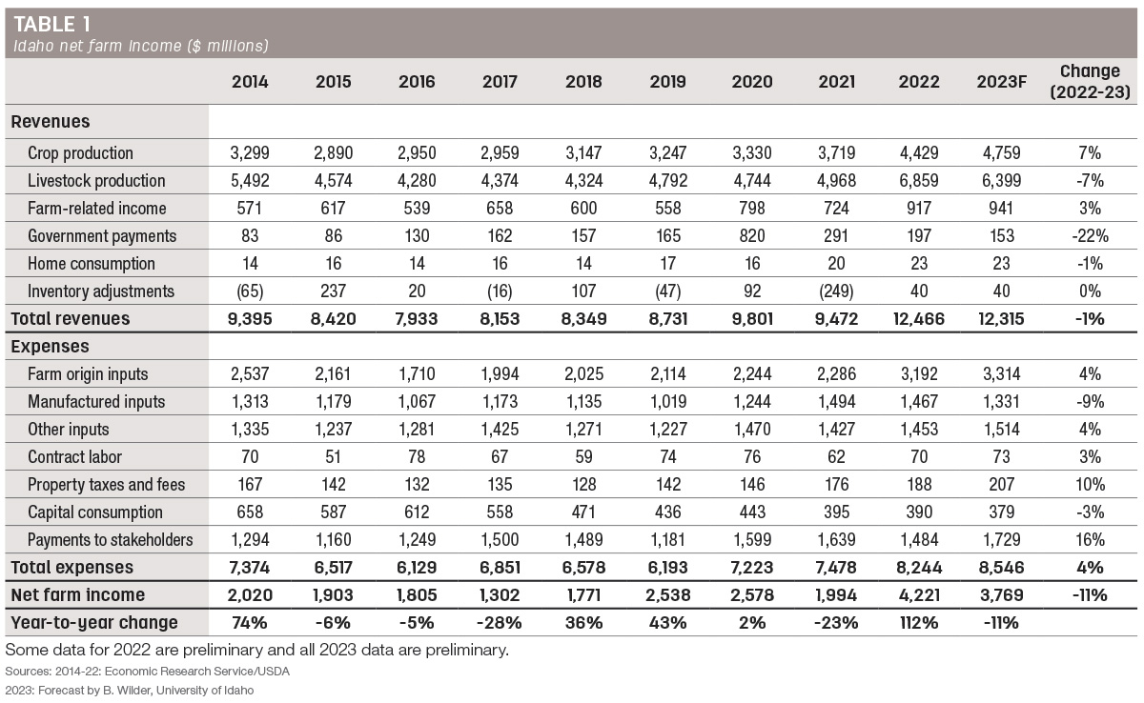
Fert/Chem
Rents/ Interest
Notes:
The overall increase in farm expenses in 2022 is primarily attributed to 40% increases in manufactured (fertilizer, chemicals and fuel) inputs, 17% increases in payments to stakeholders (non-cash compensation, net rents and interest expense), and 13% increases in farm origin (feed, seed and replacement livestock purchases). All other inputs, including labor, property taxes and fees, and capital consumption all increased by percentages ranging from 2% to 11% relative to 2021.

Slide 23
Going forward
Boring can be good
Look for input prices to be FLAT or slightly lower
Expect output prices to be moderately lower
Together – this means tighter margins for producers
Geopolitics may yet play a larger role
Recession is on the table, but we seem to have made it through unscathed
Then again… It IS an election year – anything could happen!

Slide 24
Questions?
Contact: bwilder@uidaho.edu

