Slide 1
Idaho Bean School
Twin Falls
Jan 25, 2023
Input trends

Slide 2
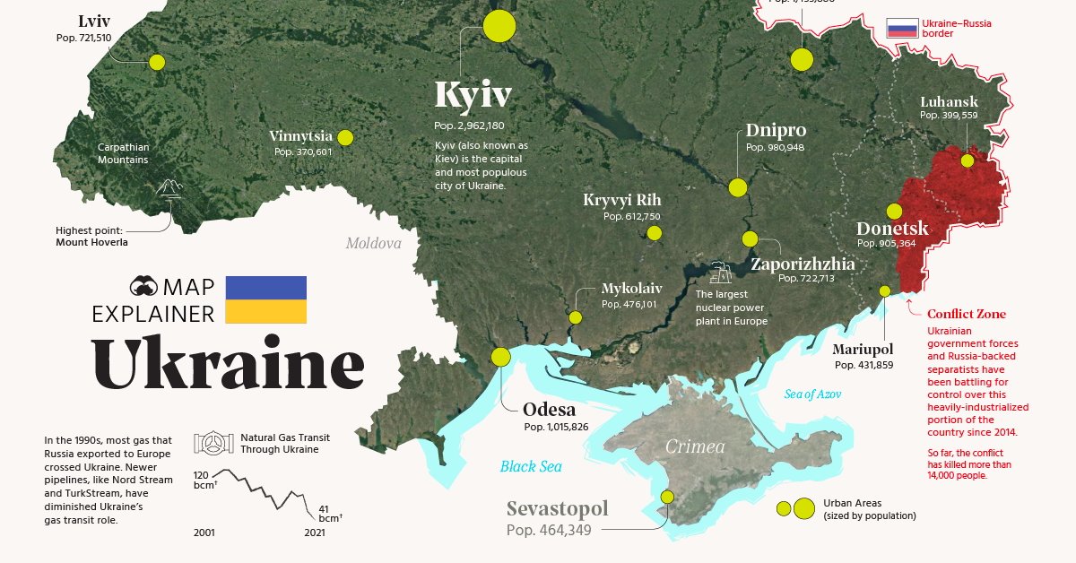
The story we’re tired of Hearing…
Big 2022 Events
Russia-Ukraine War – Natural Gas, Oil, Fertilizer – and more?
Inflation
  Interest Rates
Covid-19 Supply Chain Disruptions
Recession?

Slide 3
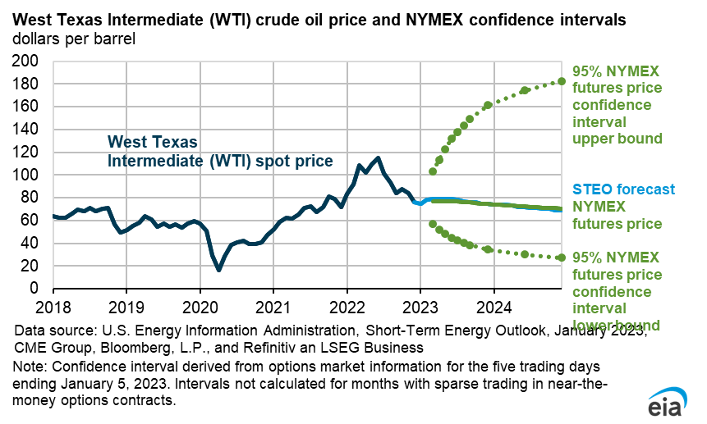
Forecast

Slide 4
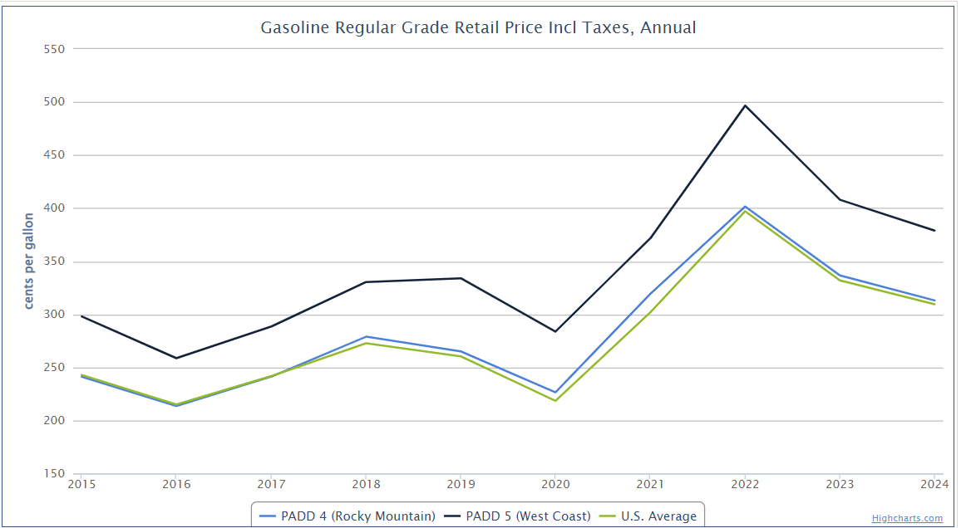
Forecast

Slide 5
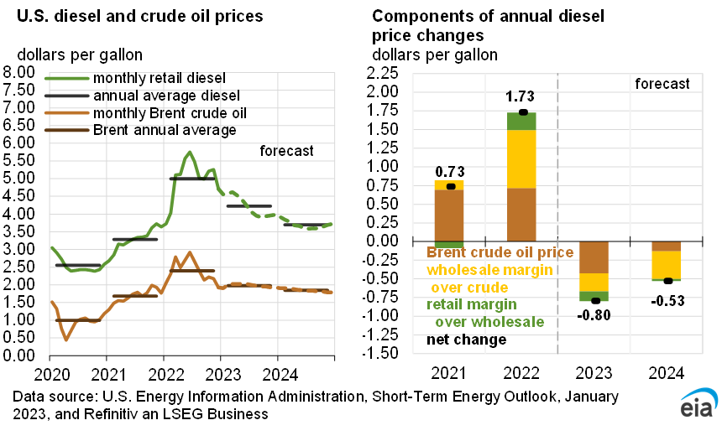

Slide 6
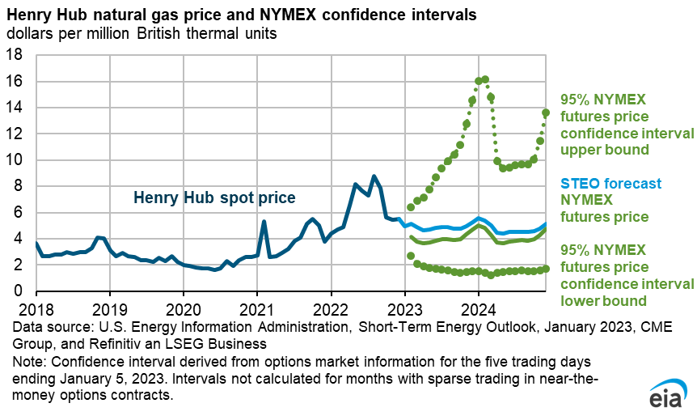
Forecast

Slide 7
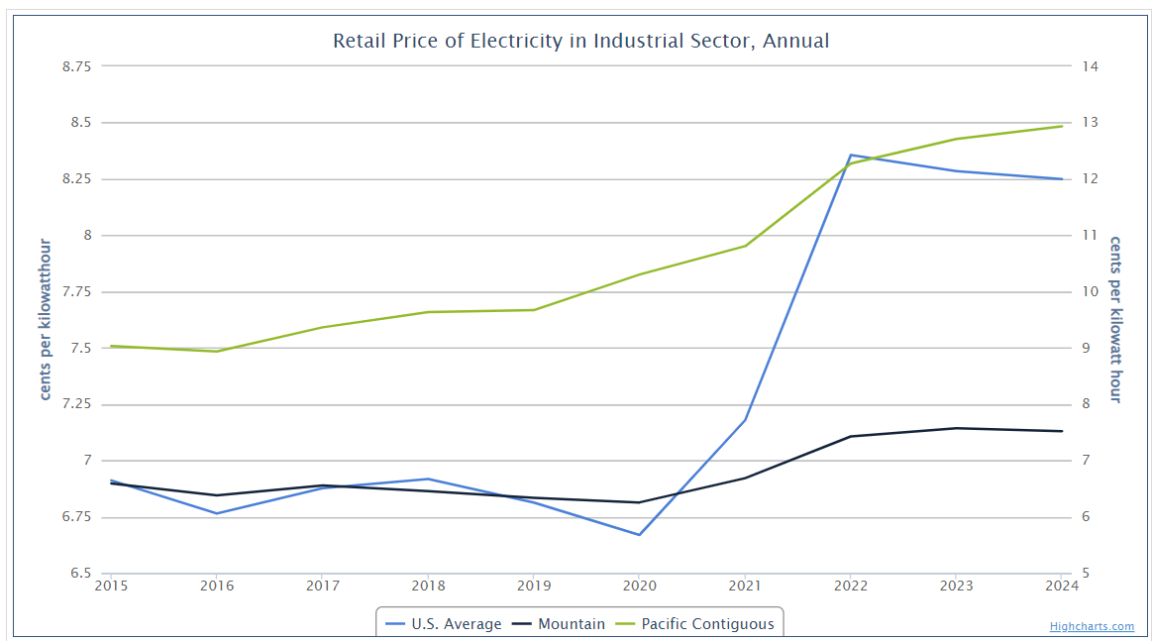
Forecast

Slide 8
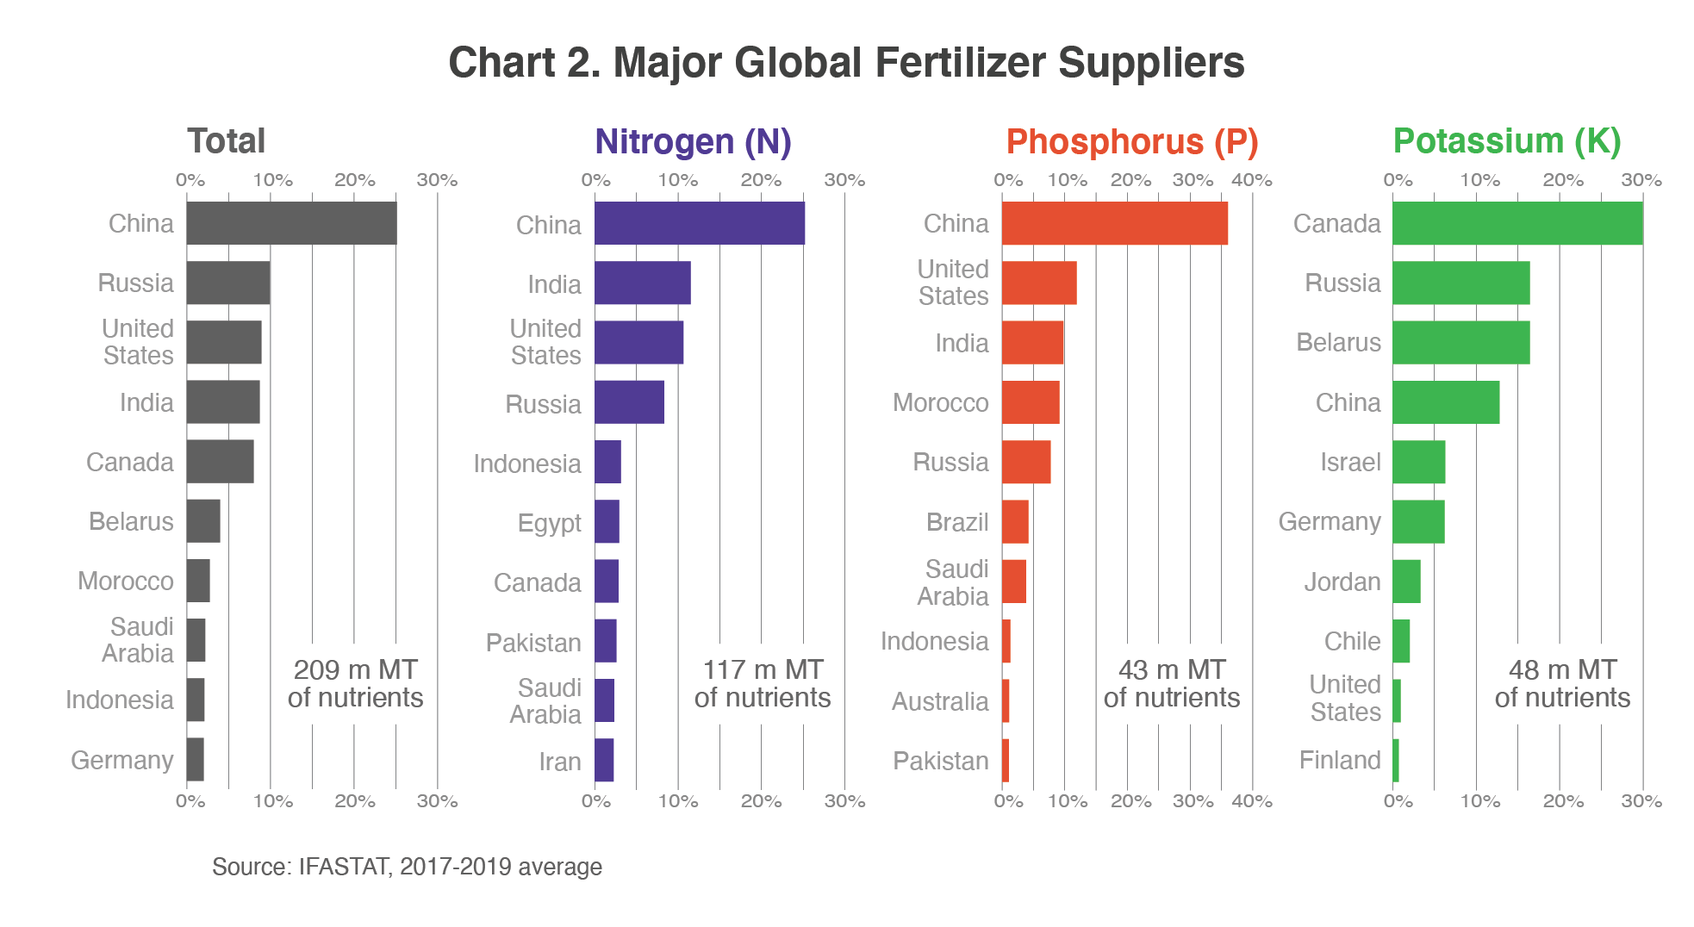

Slide 9
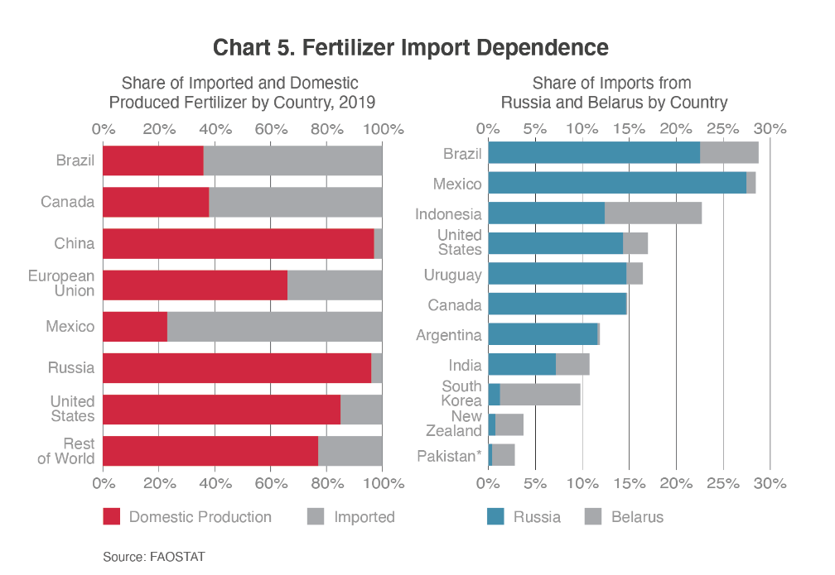

Slide 10
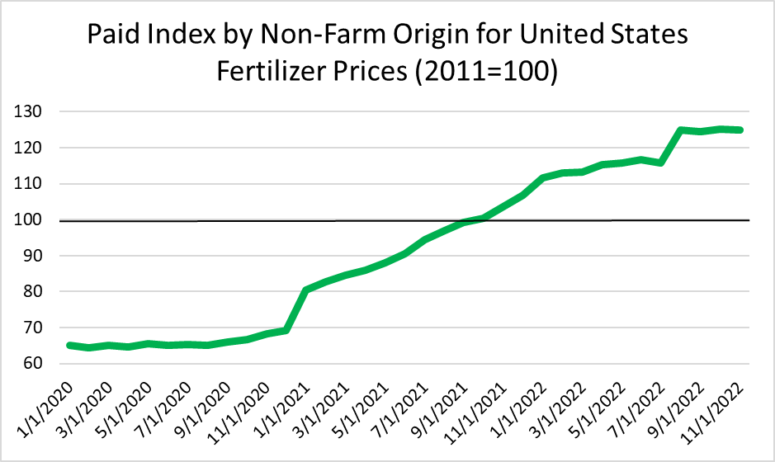
92% increase!

Slide 11
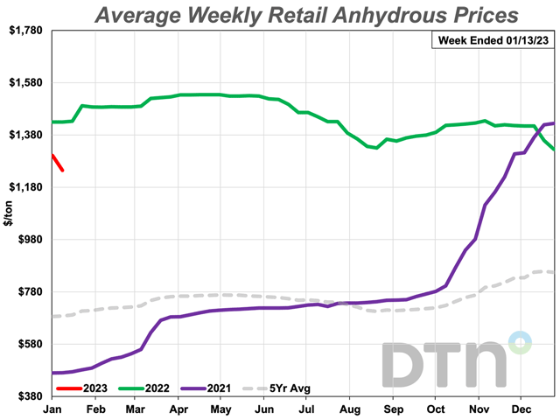
Up nearly 250% at peak!

Slide 12
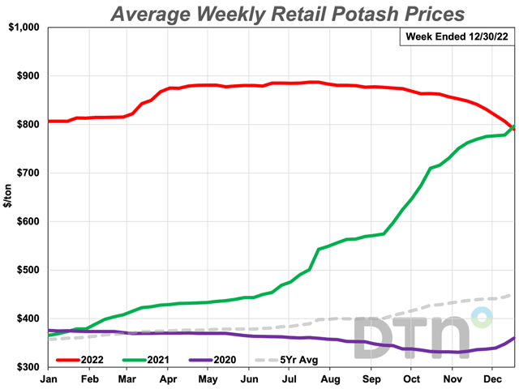
Up around 125% at peak!

Slide 13
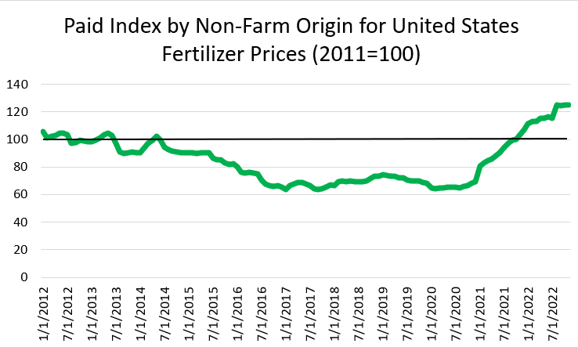
18% increase relative to 2011

Slide 14
Fertilizer Market Madness…
It wasn’t JUST russia
Natural Gas Price increases led to reduced ammonia production – especially in Europe – Major impact on Nitrogen prices
Coal price increases in China led to a rationing of electricity usage
  This caused some fertilizer production plants to decrease production; Led to a Chinese export quota
    Primarily Impacted Phosphate
Supply Chain issues aren’t done – but are better than they were
Demand Side also contributed – Grain prices are moderating in 2023

Slide 15
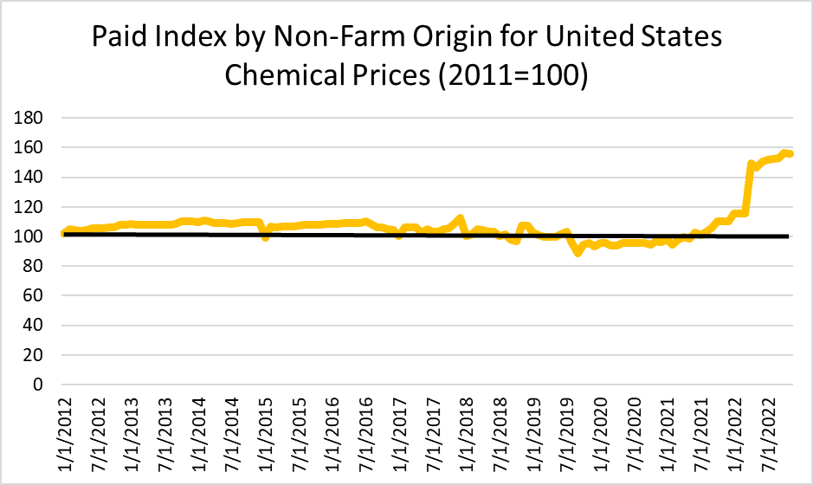

Slide 16
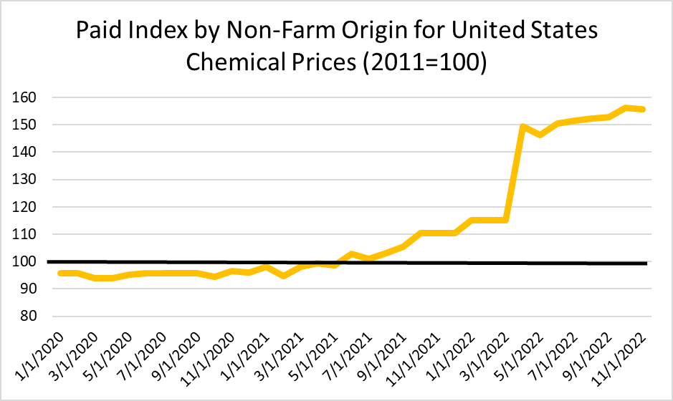
63% increase!

Slide 17
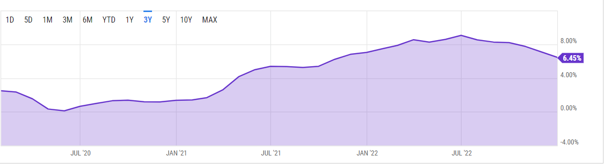
Big Picture: inflation
9.06%
6.45%
0.12%

Slide 18
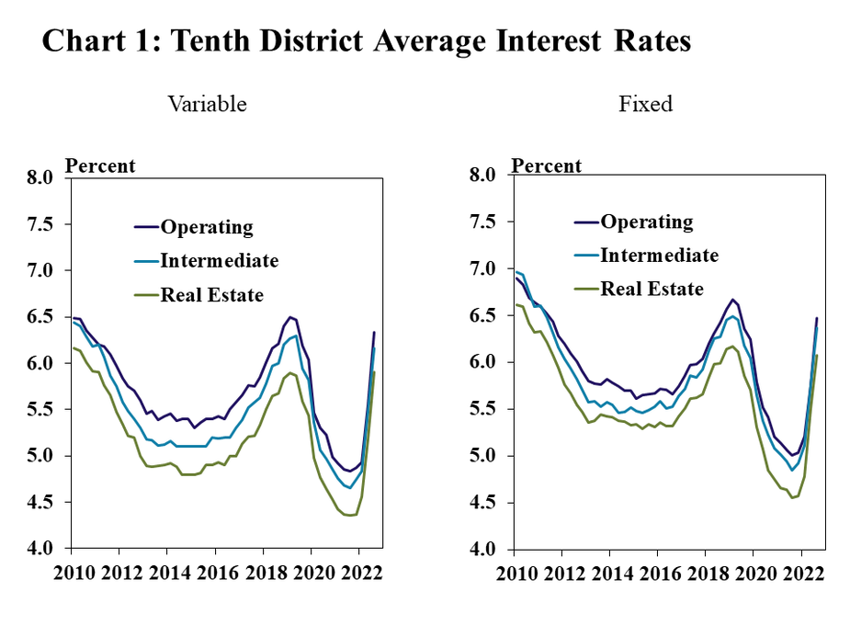

Slide 19
Magic Valley $8,000
Source: Northwest FCS proprietary database

Slide 20
Treasure Valley $30,000
Source: Northwest FCS proprietary database

Slide 21
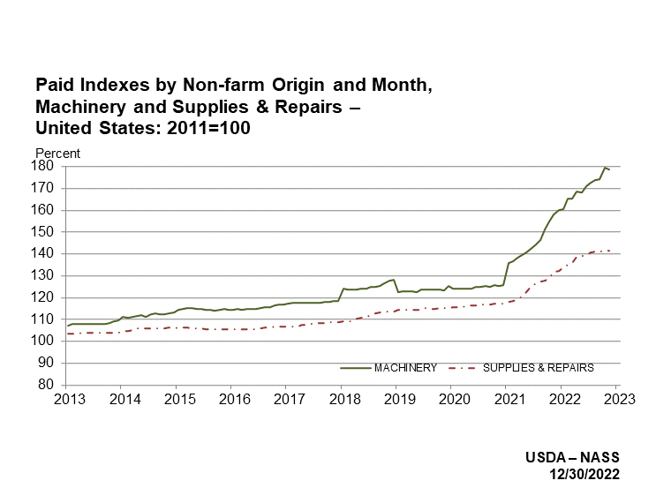

Slide 22
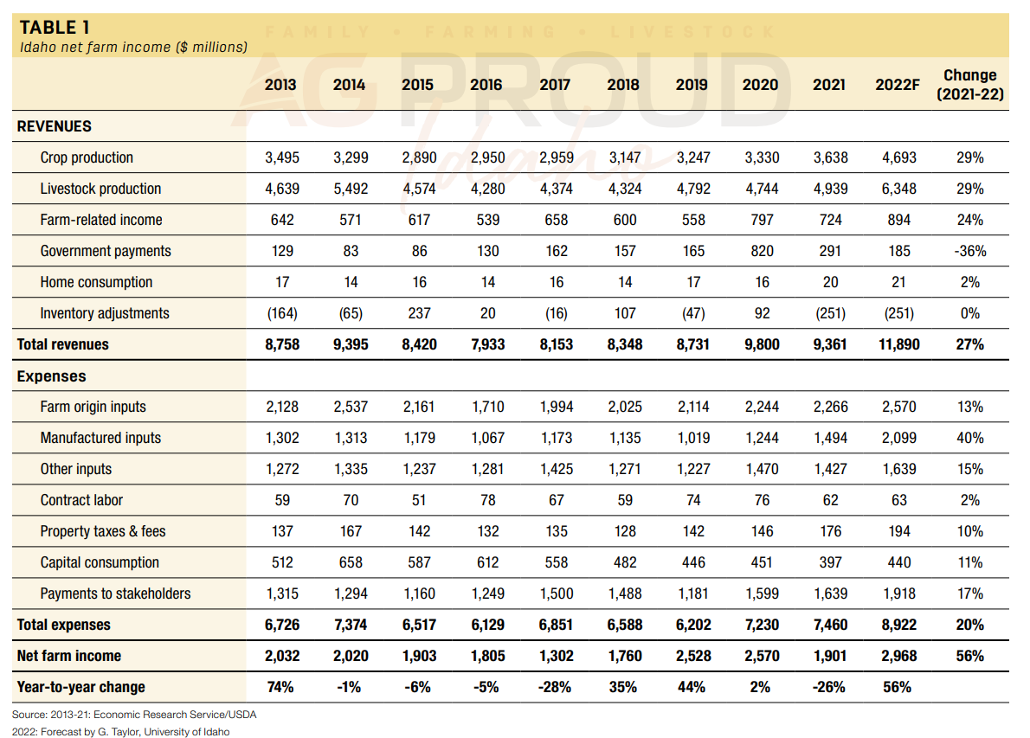
Fert/Chem
Rents/
Interest
Notes:
The overall increase in farm expenses in 2022 is primarily attributed to 40% increases in manufactured (fertilizer, chemicals and fuel) inputs, 17% increases in payments to stakeholders (non-cash compensation, net rents and interest expense), and 13% increases in farm origin (feed, seed and replacement livestock purchases). All other inputs, including labor, property taxes and fees, and capital consumption all increased by percentages ranging from 2% to 11% relative to 2021.

Slide 23
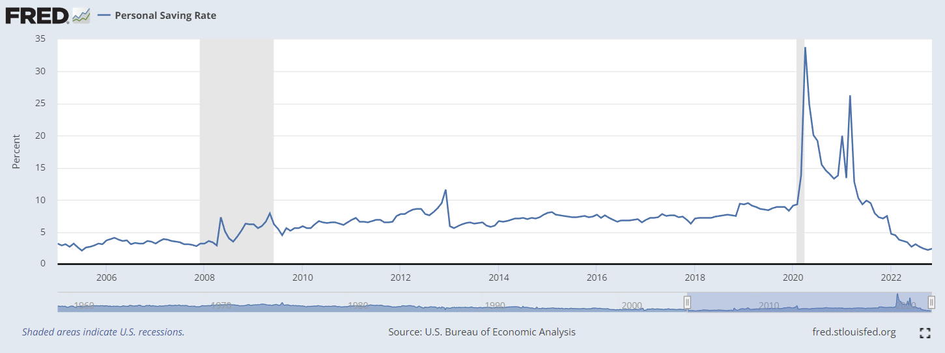
Indicators to watch: Personal Savings

Slide 24
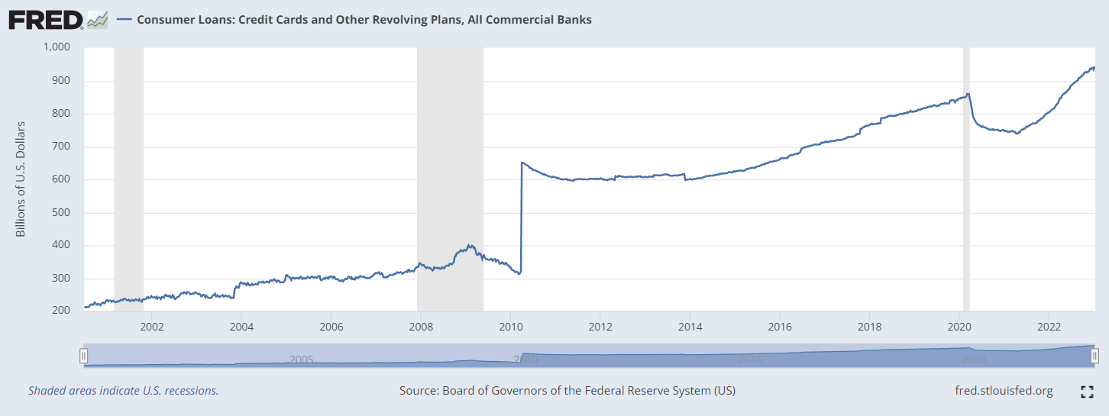
Indicators to watch: Consumer debt

Slide 25
Going forward
Margins matter
Look for input prices AND output prices to moderate
IF we enter a recession… It likely won’t be until later in the year
  Higher relative input costs in the spring and summer
  A chance of lower relative output prices in the Fall
Margins Matter

Slide 26
Questions?
Contact: bwilder@uidaho.edu

