Slide 1
Bean Diseases: Identification and Diagnosis
Lara Brown
ISDA Plant Pathologist

Slide 2
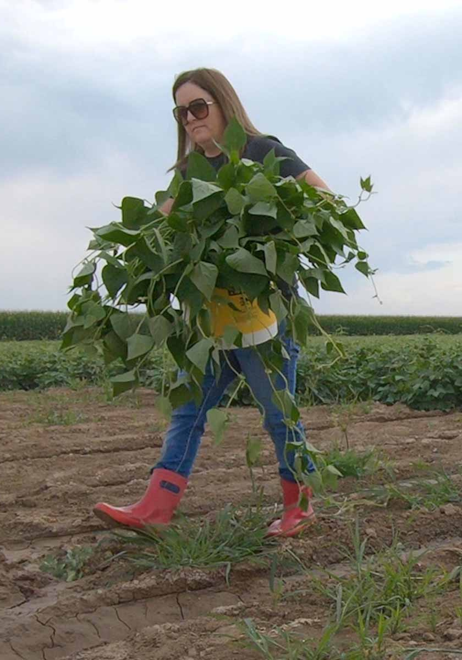
Introduction
Lara Brown
Bachelor’s in Biology from The College of Idaho
Master’s in Plant Pathology from University of Idaho
Thesis on Rhizoctonia diseases of Beans and Cereal Crops
Worked at the U of I Parma Research Center
Experience in diagnostics of crops, nursery stock, turf grasses and trees
Experience in microbiology, molecular and genetic techniques
Agronomy/in field experience

Slide 3
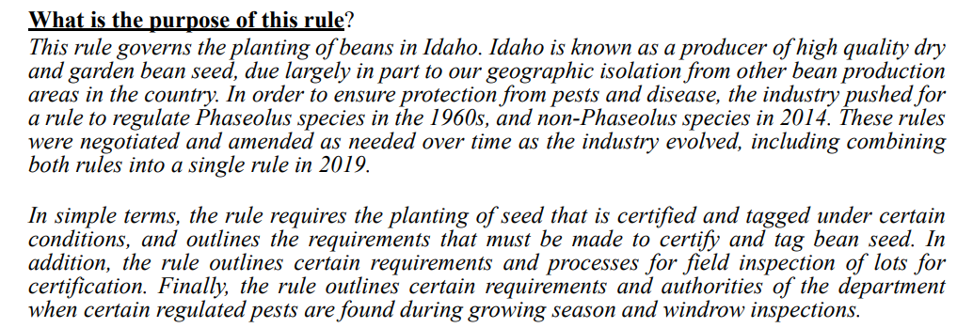
IDAPA 02- Idaho Department of Agriculture Plants Division 02.06.06 – Rules Governing the Planting of Beans

Slide 4
Bean Rule Summary
Phaseolus and Non-Phaseolus seed intended to be planted in Idaho is required to have a serology test.
Sample must be officially inspected and pulled
Phaseolus in-season inspections for regulated pathogens
Rill or furrow irrigated fields: At least one growing season and one windrow inspection
Sprinkler irrigation fields: At least two growing season and one windrow inspection
Trial ground: A minimum of four growing season and one windrow inspection
Non-Phaseolus in-season inspections for regulated pathogens
Rill or sprinkler irrigated fields: At least one growing season and one windrow inspection

Slide 5
What is my role in the bean industry?
Diagnostics on:
Bean Serologies
Field inspection samples
Additional testing requests
Non-Official samples
Training field inspectors on disease identification
Monitoring current and new pathogens

Slide 6
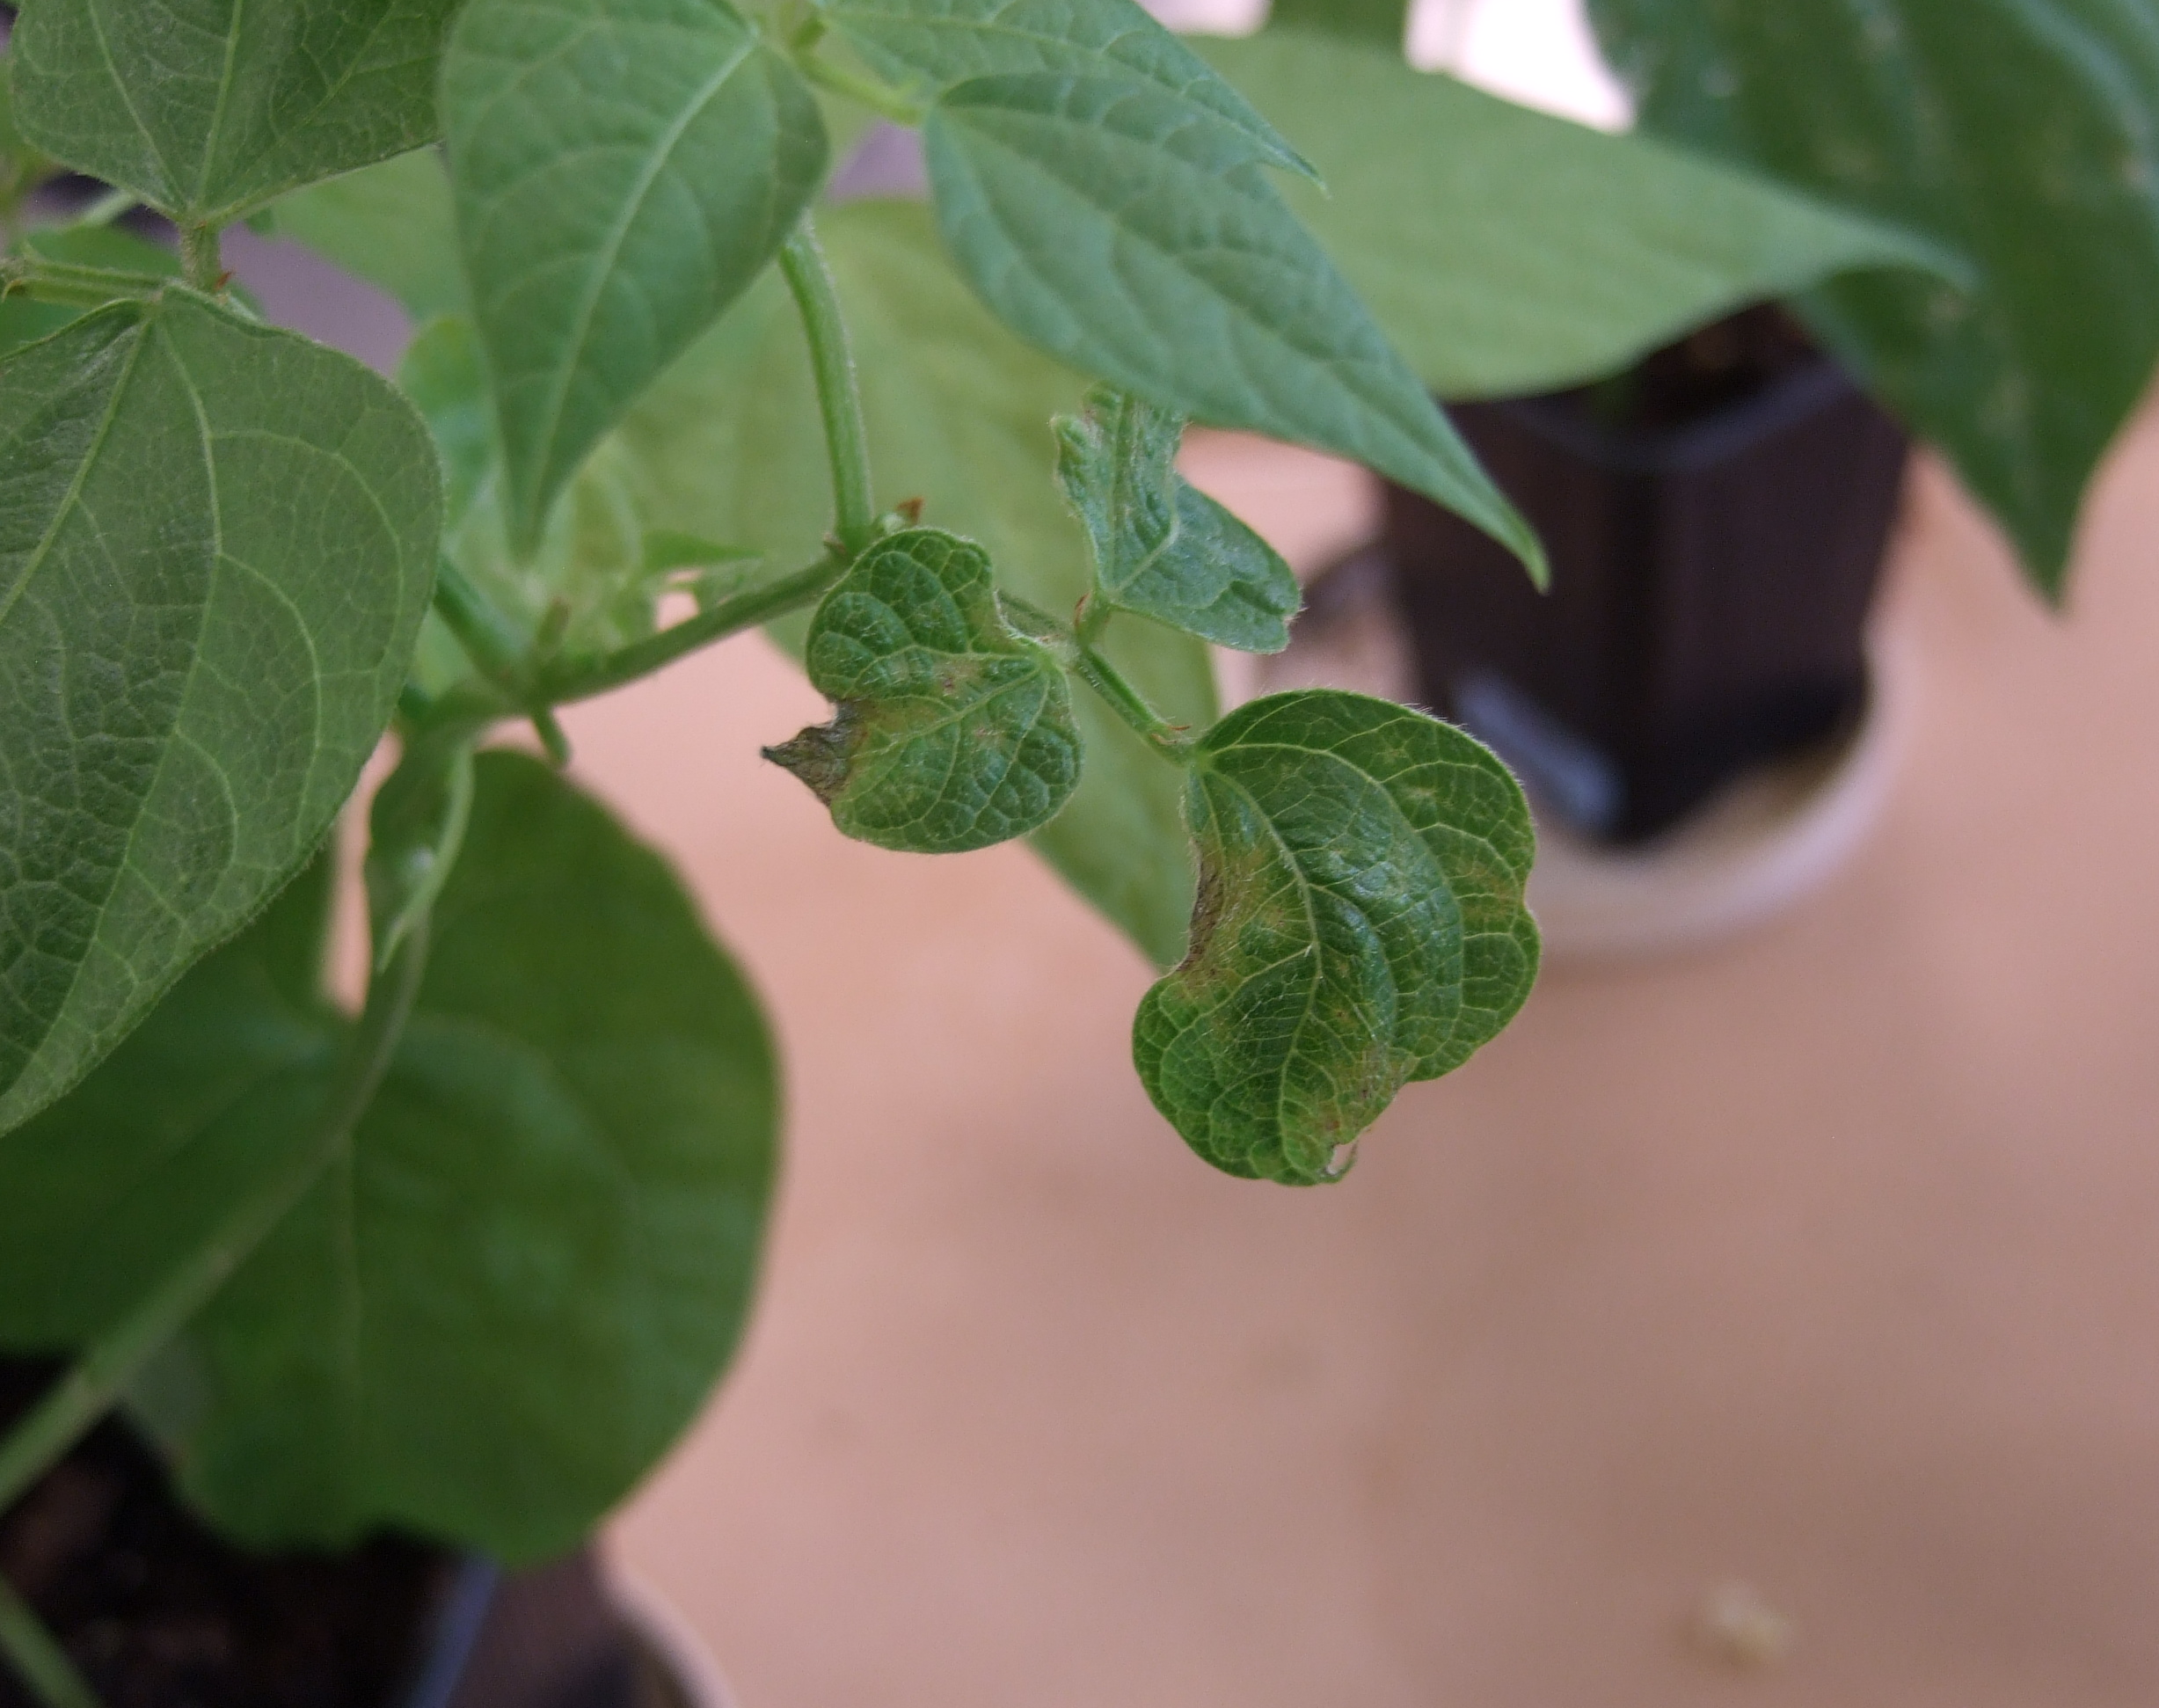
Disease Identification Regulated Pathogens

Slide 7
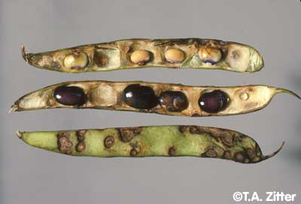
Bean Anthracnose
Causal organism:
Colletotrichum lindemuthianum
Symptoms:
Black-red sunken cankers on infected pods and seeds
Cankers develop a black ring with a red outer border and salmon colored center as infection progresses
Bean Anthracnose / Dry Beans / Agriculture: Pest Management Guidelines / UC Statewide IPM Program (UC IPM) (ucanr.edu)
Bean:Anthracnose Photos (cornell.edu)

Slide 8
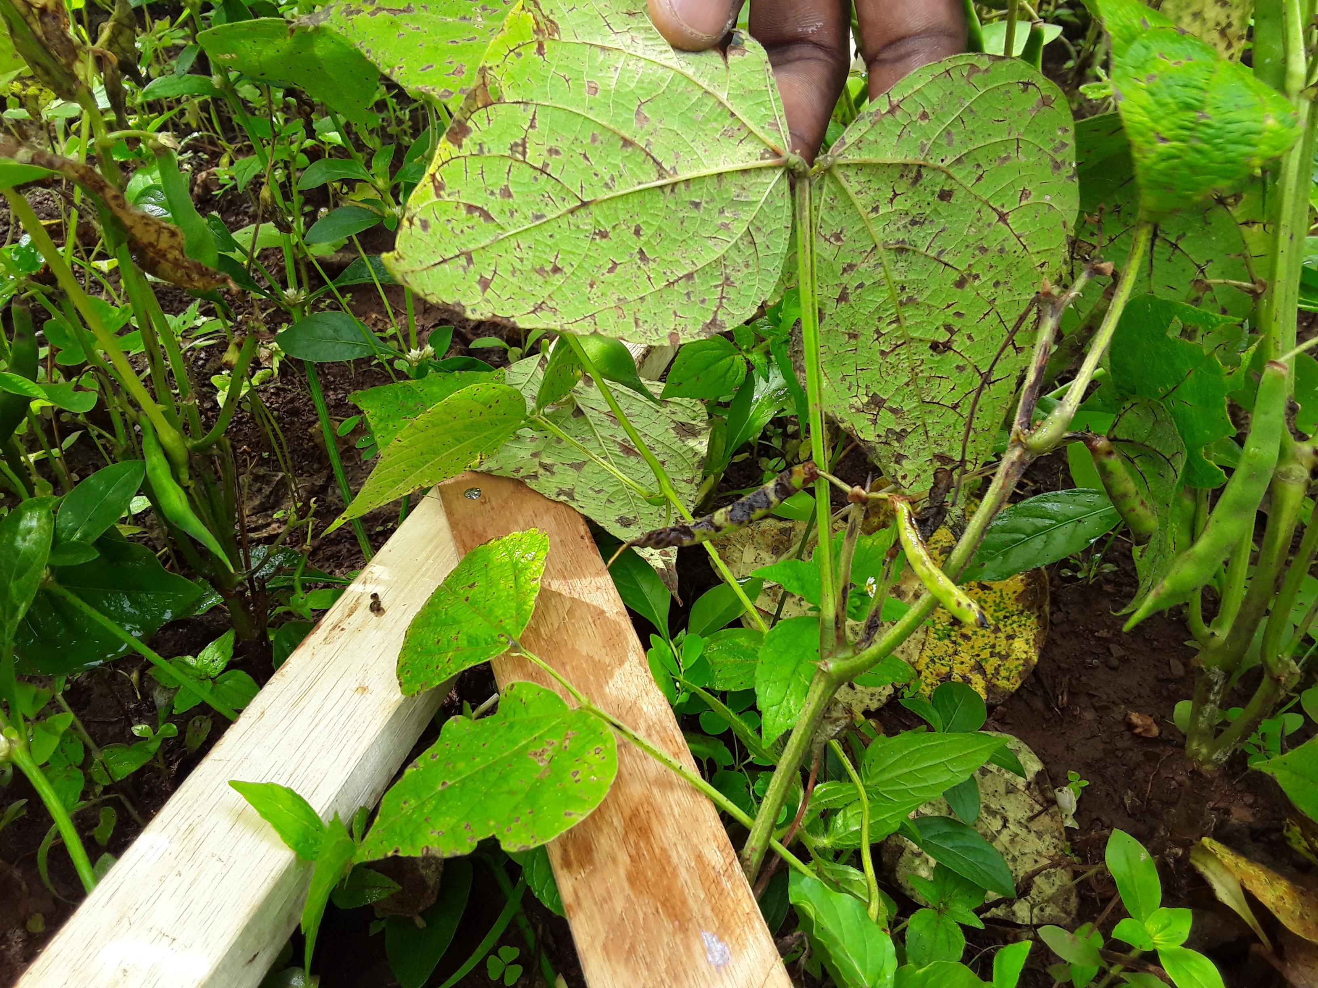
Red-brown spots and streaks on the stems, petioles and leaves
Veins turn brick-red to purple on the underside of an infected leaf
Symptoms can occur as early as the emergence of a seedling
Anthracnose on common bean.: Colletotrichum lindemuthianum; : PlantwisePlus Knowledge Bank: Vol Pest Management Decision Guides, No null

Slide 9
Bean Anthracnose Continued
Pathogen is vectored by wind and water
Overhead sprinkler systems can increase infection in the field
Distributed worldwide
Greater losses occur in temperate to subtropical zones
Lower losses occur in semiarid areas due to low rainfall and high temperatures during growing season
Pathogen can enter without wounds

Slide 10
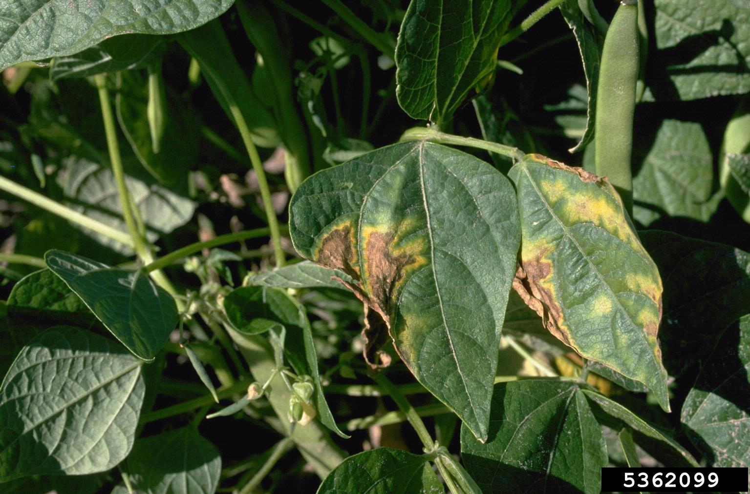
Bacterial Wilt
Causal organism:
Curtobacterium flaccumfaciens pv. flaccumfaciens
Symptoms:
Wilting during moisture stress
Interveinal chlorosis and necrosis
Infected seeds can be yellow or purple in color
Seedlings can be stunted or die
bacterial wilt (Curtobacterium flaccumfaciens pv. flaccumfaciens) on common bean (Phaseolus vulgaris ) - 5362099 (ipmimages.org)

Slide 11
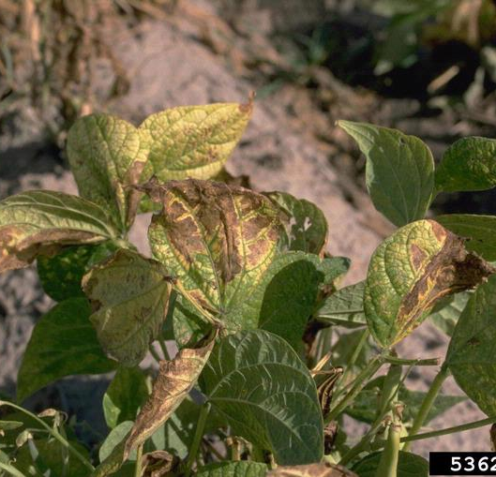
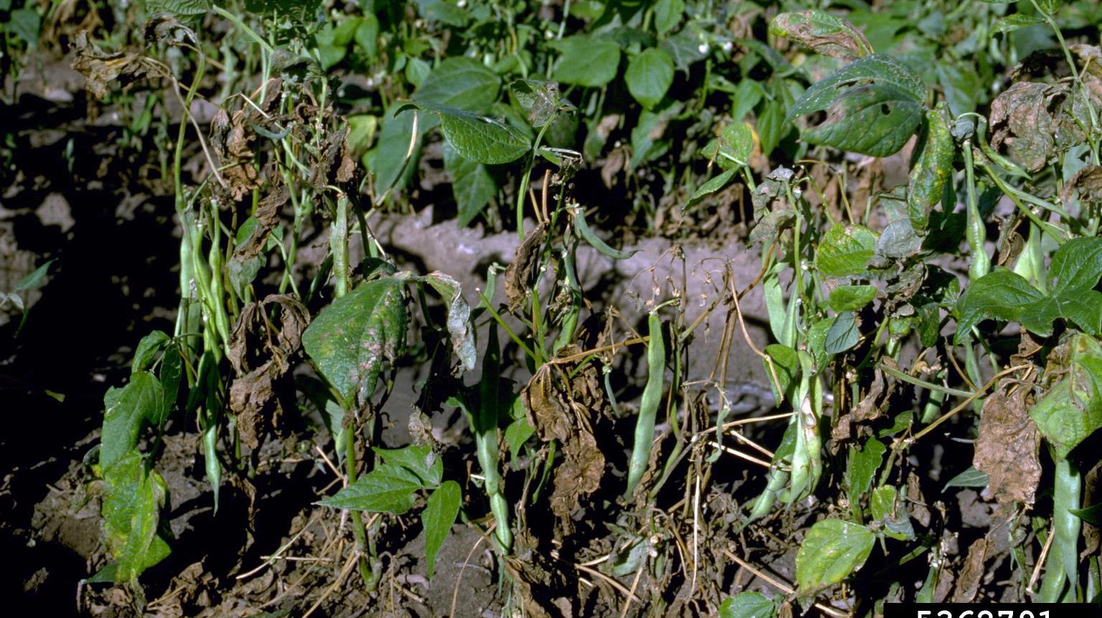
bacterial wilt (Curtobacterium flaccumfaciens pv. flaccumfaciens) on common bean (Phaseolus vulgaris ) - 5362103 (forestryimages.org)

Slide 12
Bacterial Wilt Continued
Pathogen is vectored by wind and water
Pathogen must enter the vascular system via seed or wounds to plants
Distributed worldwide
Greater losses occur in dry, hot summers with extended drought periods
Quarantine pathogen with zero tolerance in several countries
Root-knot nematodes shown to provide a mechanical injury that can introduce the pathogen

Slide 13
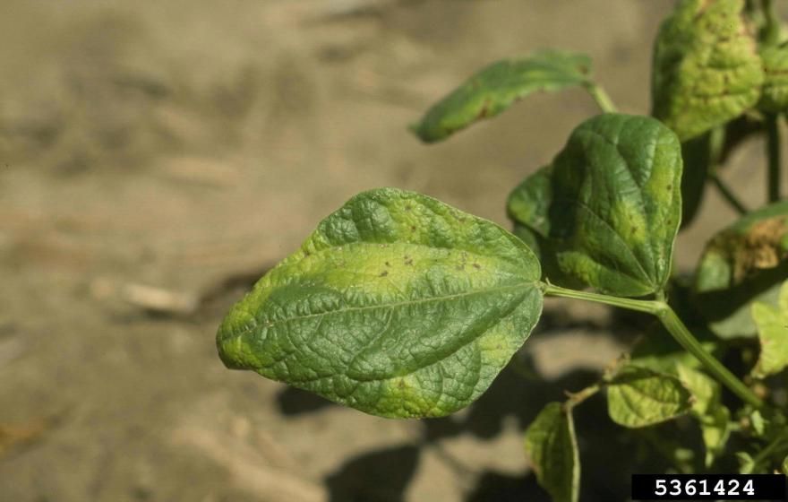
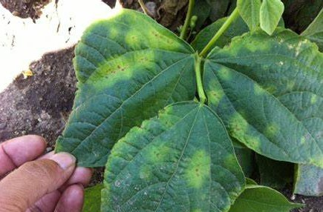
Halo Blight
Causal organism:
Pseudomonas savastanoi pv. phaseolicola
Symptoms:
Necrotic spots remain small with a yellow-green chlorotic zone surrounding (halo effect)
Leaf distortion
Small water-soaked spots that become necrotic on leaves and stems
Halo Blight | Bean IPM (pbgworks.org)
Crop & Pest Report | NDSU Agriculture and Extension

Slide 14
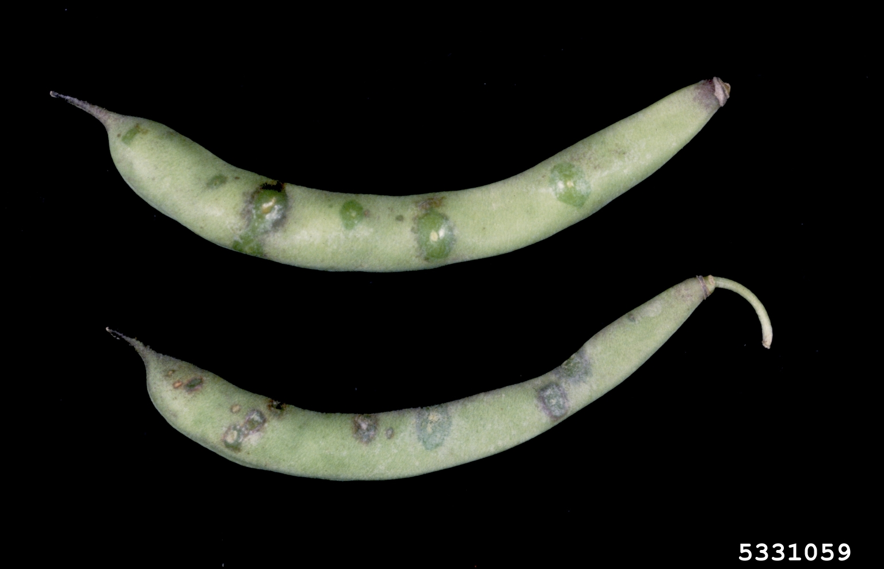
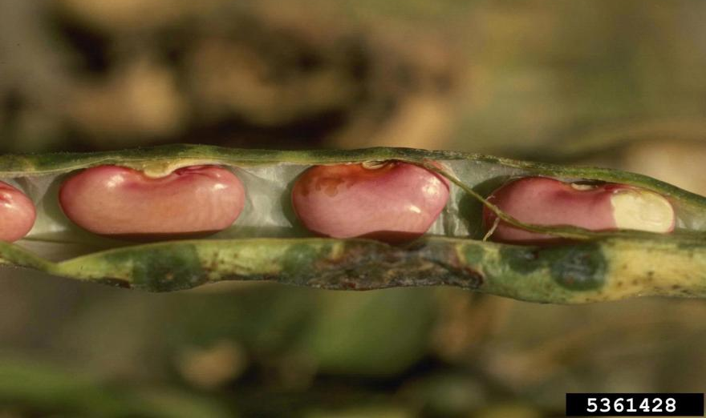
Water-soaked, red-brown lesions appear on pods
Seeds can become shriveled or discolored if severe pod infection occurs
Seedlings from contaminated seed can harbor a large amount of the pathogen before symptoms appear
halo blight (Pseudomonas savastanoi pv. phaseolicola) on bean (Phaseolus spp. ) - 5331059 (ipmimages.org)

Slide 15
Halo Blight Continued
Pathogen is vectored by wind and water
Pathogen enters through natural openings or wounds to plants
Distributed worldwide
Greater losses occur in moderate temperatures
Pathogen can grow epiphytically on susceptible and resistant genotypes with no disease symptoms occurring
Secondary spread occurs from splash dispersal and contact of adjacent leaves
Usually detected shortly after seedling emergence

Slide 16
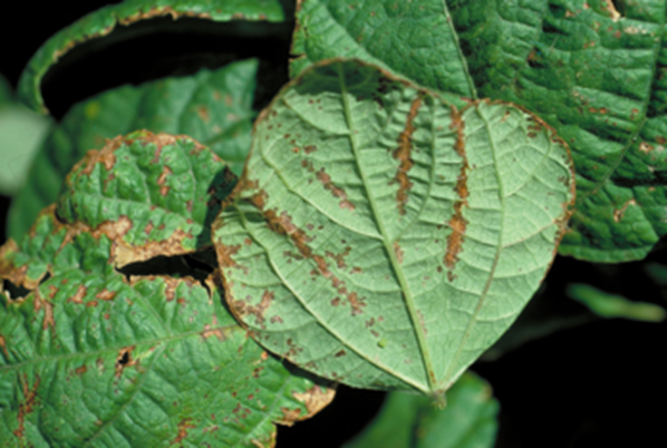
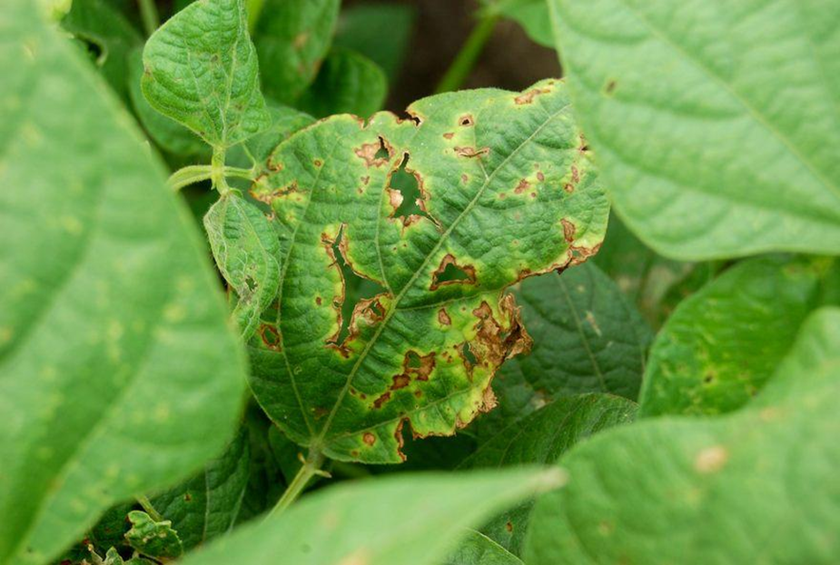
Bacterial Brown Spot
Causal organism:
Pseudomonas syringae pv. syringae
Symptoms:
Lesions can enlarge and coalesce with other lesions
Lesions can enlarge and coalesce with other lesions
Small, circular, brown and necrotic lesions that are surrounded by a yellow zone on the leaf
Bacterial Brown Spot | Bean IPM (pbgworks.org)

Slide 17
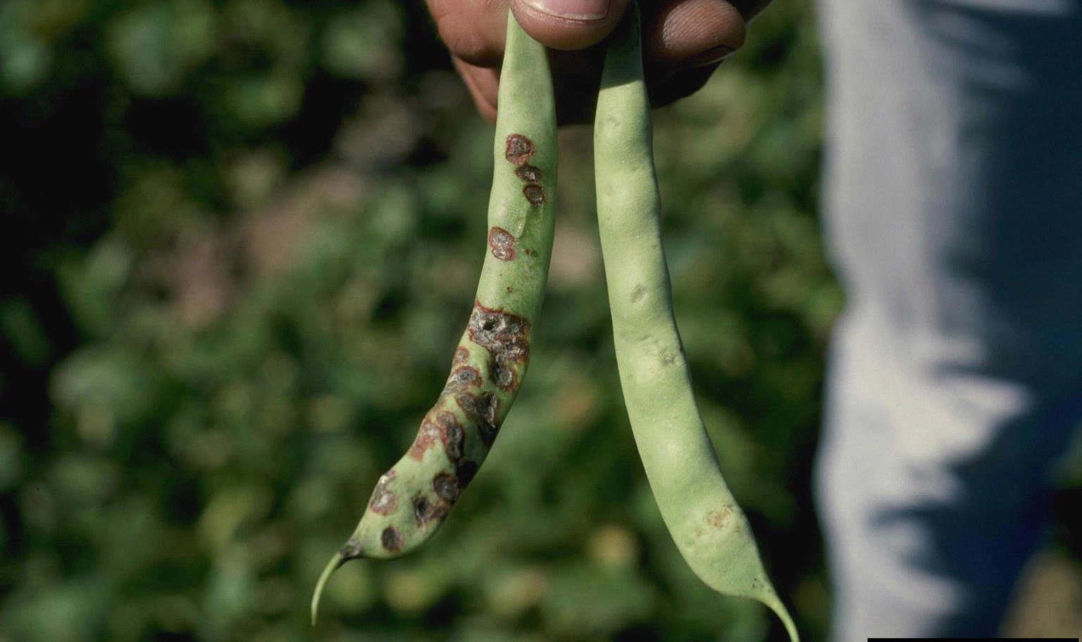
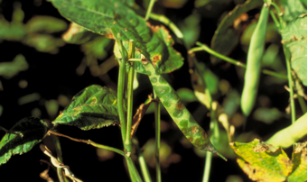
Initial water-soaked, circular lesions on pods
Lesions become brown and necrotic
Stem lesions are occasionally observed
bacterial brown spot of bean/canker of stone fruit, twig blight (Pseudomonas syringae pv. syringae) on common bean (Phaseolus vulgaris ) - 5363925 (invasive.org)
Bacterial Brown Spot | Bean IPM (pbgworks.org)

Slide 18
Bacterial Brown Spot Continued
Pathogen is vectored by wind and water
Pathogen enters through natural openings or wounds to plants
Distributed in the United States and Brazil
Greater losses occur in warm temperatures
Pathogen can grow epiphytically on susceptible and resistant genotypes with no disease symptoms occurring
Secondary spread occurs from splash dispersal and contact of adjacent leaves
Overhead sprinkler systems can increase infection in the field

Slide 19
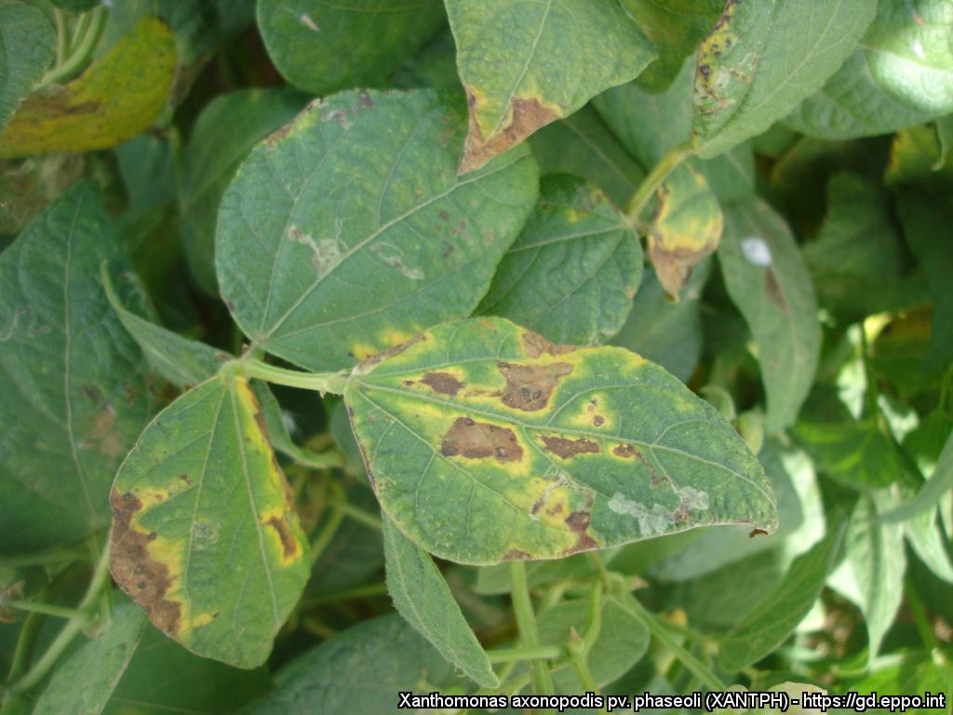
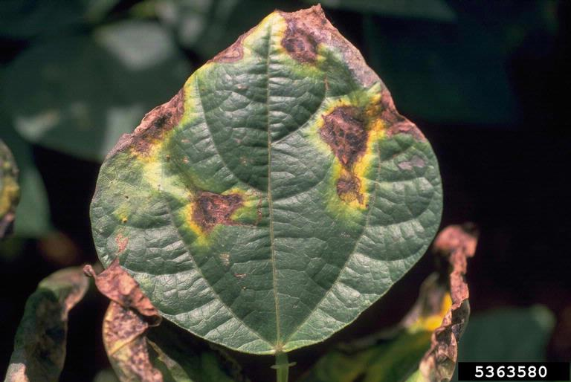
Common Bacterial Blight
Causal organism:
Xanthomonas axonopodis pv. phaseoli
and
Xanthomonas fuscans pv. fuscans
Symptoms:
Lesions are found interveinal and on margins of the leaves
Water-soaked spots that enlarge and become necrotic lesions surrounded by lemon-yellow tissue on the leaf
Progressed lesions can look as if the leaf had been burned
Common bacterial blight of beans, fuscous blight (Xanthomonas axonopodis pv. phaseoli) on common bean (Phaseolus vulgaris ) - 5363580 (ipmimages.org)

Slide 20
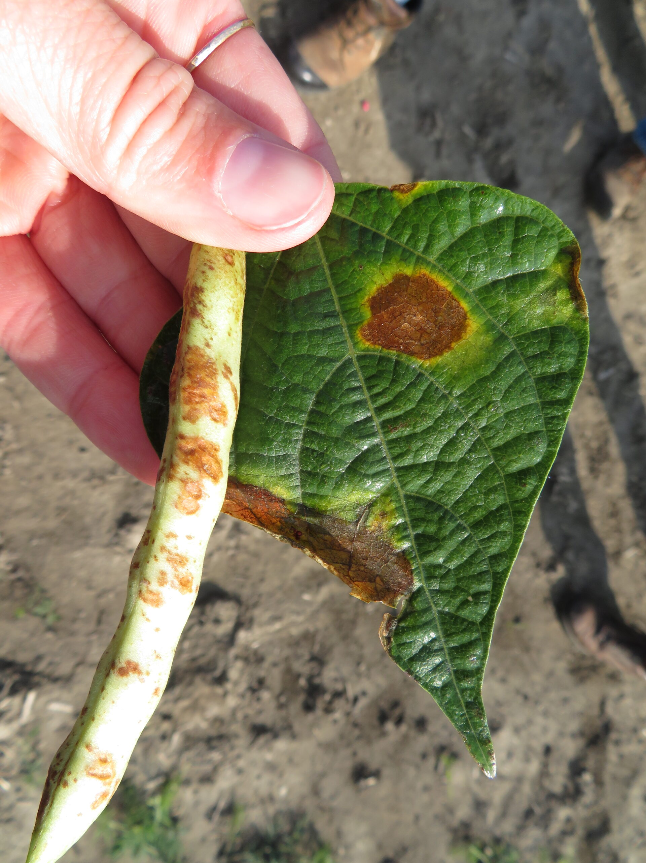
Lesions on pods are dark red, circular and slightly sunken
Bacterial ooze can be observed on pods in highly humid conditions
Infected seeds can have butter yellow to brown spots
Severely infected seeds can be shriveled
Seedlings from contaminated seed can harbor a large amount of the pathogen before symptoms appear
Impact of common bacterial blight resistance in dry bean cultivars 2003-2004 – Dry Bean Agronomy

Slide 21
Common Bacterial Blight Continued
Pathogen is vectored by wind, water, insects, animals and machinery
Pathogen enters through natural openings or wounds to plants
Distributed in the United States and Brazil
Greater losses occur in hot, wet and humid areas
Pathogen can grow epiphytically on several nonhost plants, serving as an inoculum reservoir
Secondary spread occurs from splash dispersal and contact of adjacent leaves
Overhead sprinkler systems can increase infection in the field

Slide 22
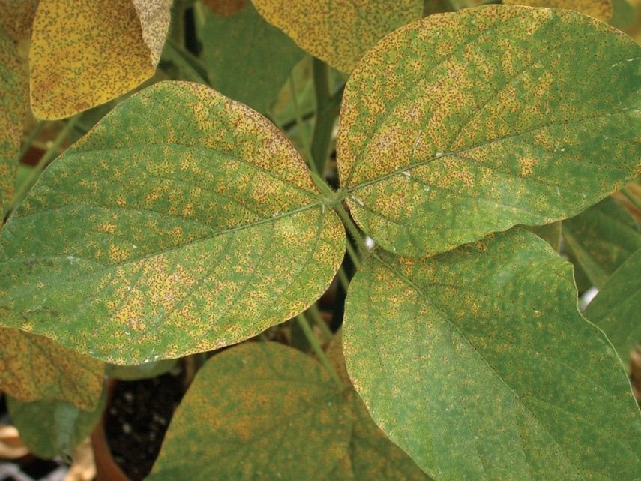
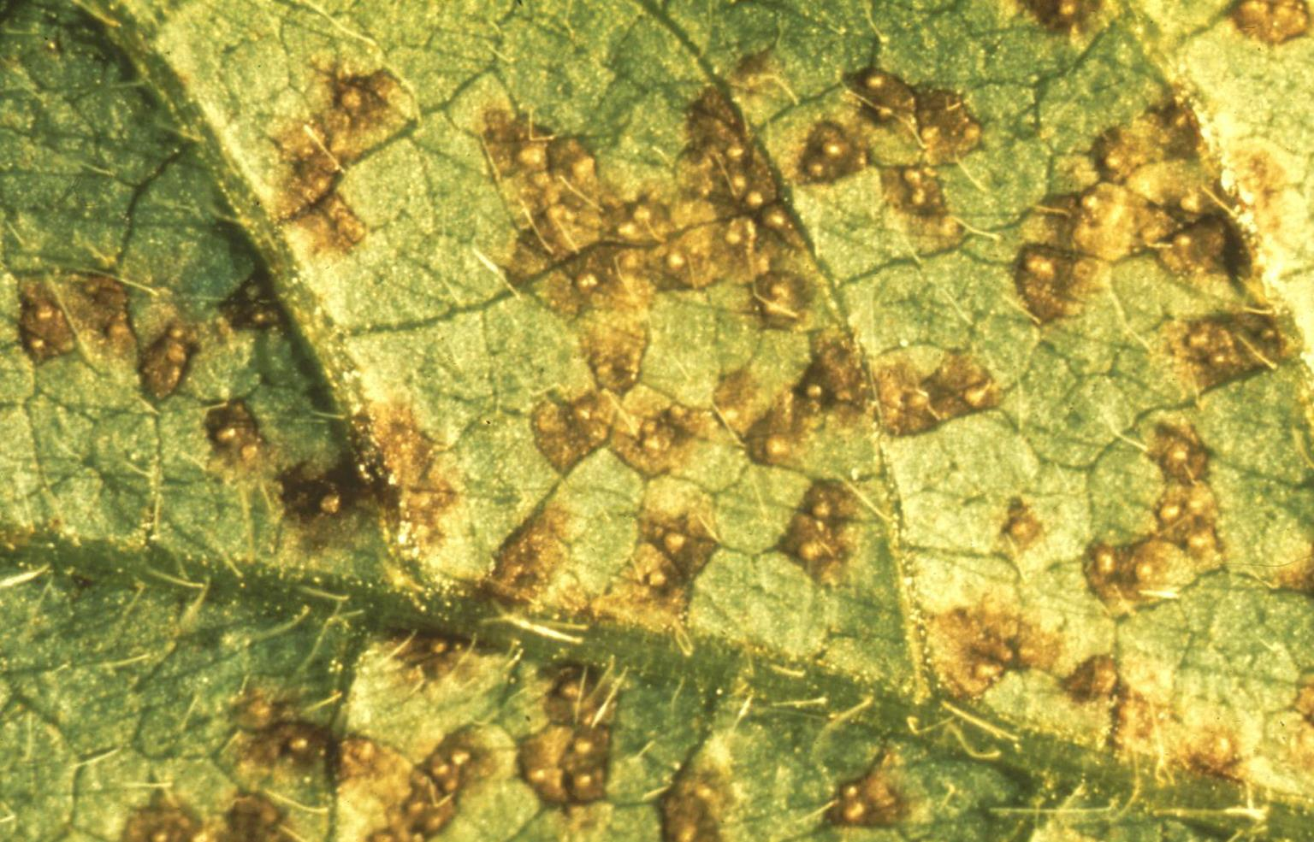
Asian Soybean Rust
Causal organism:
Phakopsora pachyrhizi
Non-Phaseolus ONLY
Symptoms:
Lesions can form on pods and stems as well
Tan or reddish-brown lesions develop on the underside of the leaf first
Small blisters develop in the lesions, which break open to release spores
Soybean | Diseases and Pests, Description, Uses, Propagation (psu.edu)
ISU Experts Available to Speak About Asian Soybean Rust | College of Agriculture and Life Sciences (iastate.edu)

Slide 23
Asian Soybean Rust Continued
Pathogen is vectored by wind
Pathogen enters when leaves are wet and temperatures are between 8℃ - 28℃
Distributed in the United States and Brazil
Greater losses occur in warm, wet and humid areas
Pathogen is an obligate parasite and requires a living host
Can survive on alternative hosts, serving as an inoculum source

Slide 24
Additional Diseases Non-Regulated Pathogens
Viruses
BCMV
BCMNV
Fungi
Angular leaf spot
Fusarium
Rhizoctonia
Alternaria
Additional requests can be made

Slide 25
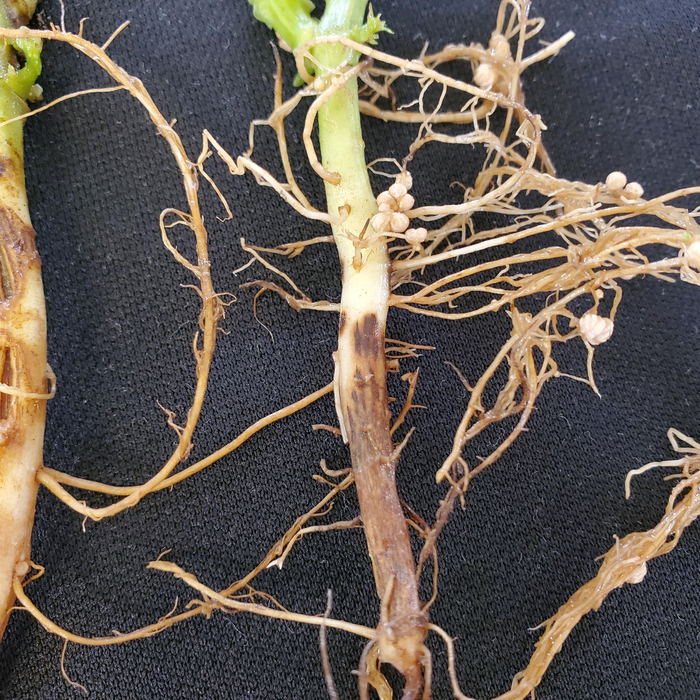
Disease Diagnosis

Slide 26
Bean Serologies
Official samples pulled by the field team through the phyto line
Pounds of seed needed varies with lot size
Three subsamples are tested for regulated bacteria pathogens
Cultures are visually assessed, plated on specialized media and undergo identification tests based on species
Seed is grown out on germination paper to assess for anthracnose
Any suspect fungi is plated on media to visually assess morphology and then sent for genomic testing to validate
Pathogenicity testing on any positive pathogens

Slide 27
Field and Greenhouse Samples
Can be officially pulled from the field team during inspections
Growers can send in samples for testing
Samples are visually assessed for symptoms of pathogen(s) requested
Testing varies based on target pathogen(s)
Culture
Elisa
Grow out

Slide 28
Future Testing
Increase TaqMan RT-PCR testing for initial results
Will maintain current testing methods to validate results
Move to an extraction method that will extract DNA and RNA

Slide 29
Summary
The bean rule is in place to protect our bean industry
Inspectors will be out to inspect in the active growing season and windrows for regulated pathogens
During active growing season, please watch for calls from the field team in the early morning to inform you when an inspector will be out
Inspectors will NOT inspect a field that has irrigation on or any pesticide application
You can contact the inspectors to perform an inspection if any disease concerns arise
You can submit samples to the lab for testing if any disease concerns arise

Slide 30
Questions?

